Slide 1
Special Topics Forum:
Community Health Worker & Family Partner Role Development
December 21st, 2021
Charlotte Vieira
Arth Hin
Anita Morris

Slide 2
Disclosure and Acknowledgements
The presenters do not have anything to disclose regarding commercial interests and do not plan on discussing unlabeled/investigational uses of a commercial product.
Funding for the TEAM UP for Children initiative was provided by the Richard and Susan Smith Family Foundation and the Klarman Family Foundation.

Slide 3
Logistics
Please add your CHC to your Zoom ID and if you would like, your preferred pronouns.
Please remember to mute if you are not speaking.
Feel free to use the chat function for ongoing comments and questions. We will keep a record.
Do what you need to take care of yourself throughout the session.
Being on camera makes for a more interactive experience together!
Put a note in the chat if you are stepping away, and thanks.
This training (and all future trainings) will be recorded.

Slide 4
Agenda
Review TEAM UP’s work to date to develop and define the role of the CHW/FP on the integrated team
Share information and feedback gathered in interviews with Cohort 1 CHWs and FPs
Gather initial input on how the CHW/FP role has evolved in Cohort 2 and introduce plans for collecting additional insights and information over the upcoming months

Slide 5
TEAM UP CHW/FP: Scope of Work
Parent coaching and support, including outreach to and engagement with families to promote healthy development and access to care and services
Linkage to basic needs resources and community services
Care coordination to help with multiple appointments, different sites of care, etc.
Screening and support for referrals, such as Early Intervention, stepped up care, etc.
Population Health Management, such as outreach to families lost to care or with care gaps
Engagement in community outreach events to promote public health messages and describe services available in Pediatrics
Notes:
The scope of work was defined early on in TEAM UP and is supported by trainings in the following evidence-based strategies:
Motivational Interviewing
Problem Solving
Family Engagement

Slide 6
Cohort 1 Role Development
Guiding Principles:
The role works well for the CHW/FPs and is rewarding and fulfilling
The role works well for patients, the care team, and the health center
The role is sustainable long term
Two primary steps identified:
Skills support: Integrate training into CHW/FP work
Role development: Data gathering to understand current status of role development
Notes:
Work with cohort 1 began late 2015/early 2016, cohort 1 CHCs included Lowell, Dimock, and Codman
Brief mention of who was part of workgroup, i.e., roles and expertise represented – recommend not focusing on the workgroup per se since it only met once and then the follow up was directly at leave CHC and then in the SC meetings.
Focus of today’s talk on the data gathering

Slide 7
Cohort 1 Role Development
Role development data gathering occurred during a meeting with CHW/FPs at each CHC and focused on five key areas:
Integrating training into your work – preparing you with the tools and skills to be successful in your work
Team-based care – understanding everyone’s role on the team
Daily activities – how you do your work each day
How you organize your work – tracking your work and the families you serve
Population health management – services for the whole population that your health center serves
Notes:
Anita and Mahader met with CHWs at each CHC for an in person interview
Five topic areas with detailed

Slide 8
Key Findings: Integrating Training Into Your Work
Universal interest in using a Problem-Solving intervention. Problem solving focus was a perfect fit for the role, especially for navigation within a set workflow, like IEPs. Interest in developing care planning skills in a manualized approach: e.g., assessment, action plan, reassessment, etc.
CHW/FPs used Motivational Interviewing and found training to be immediately helpful, particularly in the fast-paced environment of primary care.
Opportunities for meeting other CHWs to network for resources were very helpful.

Slide 9
Key Findings: Team-Based Care
CHW/FPs self-described role citing helping families access basic needs resources, care coordination to help with multiple appointments, and supporting referrals, such as Early Intervention.
The unique nature of the role – integrated into pediatrics and focused on behavioral health care – took time to develop fully. CHCs did ongoing informal trainings to reinforce the role and its responsibilities.
CHW/FPs felt care team understood role, particularly BHCs. Some variability amongst PCPs, particularly in accessing CHW/FPs for tasks that could be handled without them (e.g., written information for resource needs).

Slide 10
Key Findings: Team-Based Care
Good understanding of CHW/FP role among patients and families, but not always the limitations of role and capacity.
CHW/FP skills and contributions were generally well utilized; this improved as the role developed.
Most fulfilling, satisfying part of work was directly helping families, e.g., coordinating care so a child who is suffering can receive all the services they need, partnering with families, earning the family’s trust, coaching caregivers and seeing that coaching internalized by the caregiver.

Slide 11
Key Findings: Team-Based Care
Challenges included fast pace of primary care (not having enough time for a family that needs a deeper dive), barriers and limitations in the system (e.g., housing, school system, emergency shelters), and families suffering and having a difficult time.
Every CHW/FP had clinical and administrative supervision. Clinical supervision provided by a BHC, and each CHC had a mechanism for CHW/FPs to review difficult cases and receive peer support.
There was not consistent meeting time with PCPs, but CHW/FPs did have access to PCPs through informal meetings and huddles.

Slide 12
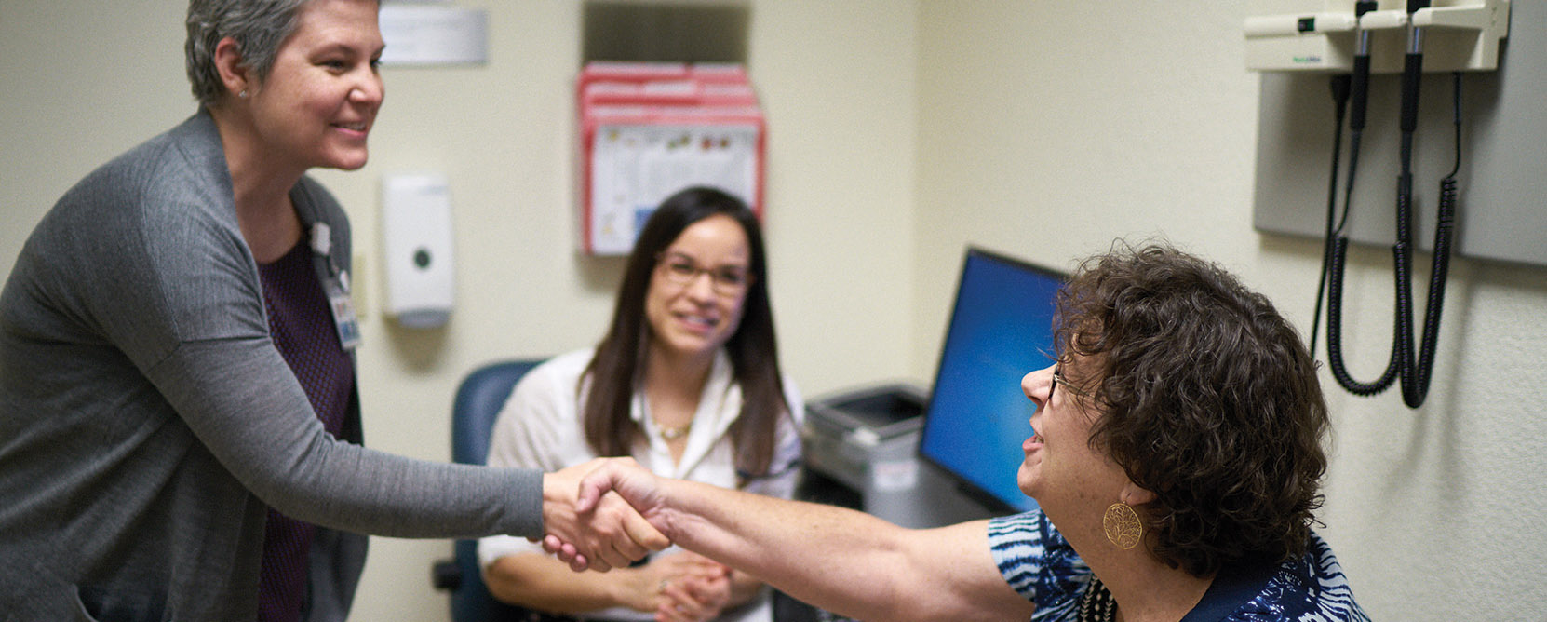
Key Findings: Daily Activities
CHW/FPs had 1-5 visits per day, or 5-25 visits per week. Majority were warm hand-offs (WHOs), follow-up visits, or off-site visits at home or at a community agency.
In addition to visits, CHW/FPs spoke to about 5-10 patients by phone or text each day, or 50 per week; at times as high as 15-20 per day.
CHW/FPs received requests in a variety of ways, including WHOs, referrals in the EMR, staff messages, telephone encounters or actions in the EMR, scrubbing PCP schedules, morning huddles, and emails. CHW/FPs received about 10-45 new discrete requests (referrals, actions, etc.) per week.

Slide 13
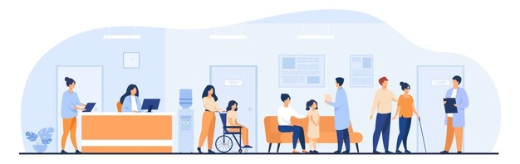
Key Findings: Daily Activities
CHW/FPs estimated more than half of patients and families served required more than one contact or touch to fully address issue at hand. On average this amounted to 2-5 touches in total per family, but complex families could require many more contacts.
For patients who need on-going contact, the CHW/FP generally maintained regular contact until they reached a natural endpoint. On average contact was on-going for 3-6 months.

Slide 14
Key Findings: Daily Activities
CHW/FPs estimated that more than half of their patients were high-risk, as defined by having multiple complex needs, more social and behavioral health issues, co-morbid chronic medical health issues, DCF involvement, and urgent risk for homelessness.
On average, CHW/FPs carried about 25-50 active patients at a time. The CHW/FP might additionally be monitoring 20-25 patients after more intense support had wrapped up. When covering for a vacant position, the CHW/FP could carry up to 80 active patients at a time.

Slide 15
Key Findings: How You Organize Your Work
2 of 3 CHCs used the EMR to track daily visits. This was in part used to document how the CHW/FP spent their time.
CHW/FPs at every CHC had some mechanism to track daily work and remind themselves about follow-up activities (EMR in-basket or Reach, with duplicate documentation in the EMR. Reach shows all active patients, and actions can be set – to email, text, call, etc. – within a defined timeframe.)
Each CHW/FP had a mechanism to track their active patient panel, however there was variability both within and between CHCs – some used a personal tracking system; others used functionality built into the EMR, such as assigning themselves to the care team.

Slide 16
Key Findings: How You Organize Your Work
All CHW/FPs documented in the EMR, both in visits and telephone encounters in the patient’s record and through staff messages.
All CHW/FPs had multiple avenues to communicate with other members of the care team, including through the EMR, staff meetings and clinical supervision, verbal updates, huddles, etc.
All CHW/FPs had multiple weekly meetings, including but not limited to clinical supervision, clinical department meetings (e.g., Pedi dept.), discipline meetings (e.g., BH meeting), and care team meetings. Some also attended meetings within the community to stay abreast of community issues.

Slide 17
Key Findings: Population Health Management
Emerging activities geared towards the entire population included preventive touches at 2 weeks and 18 months, and as part of universal screening.
There were a number of activities geared towards all members of a specific high-risk population of patients,, including families with DCF involvement, Early Intervention referrals, children with co-morbid chronic disease (asthma or diabetes) and social needs.

Slide 18
What Do You Think?
Do you see yourself, the work that you do, your experience represented in these summaries?
What is missing or needs updating, revising?
How has your work been impacted or evolved through the pandemic?
What are the most important elements of your work? How can we better capture or represent the CHW/FP role?

Slide 19
Next Steps
We want to hear more from you!
Revise and expand Cohort 1 data gathering questions
Coordinate time to meet with each team of CHW/FPs
Utilize feedback to further CHW/FP role development

