Slide 1
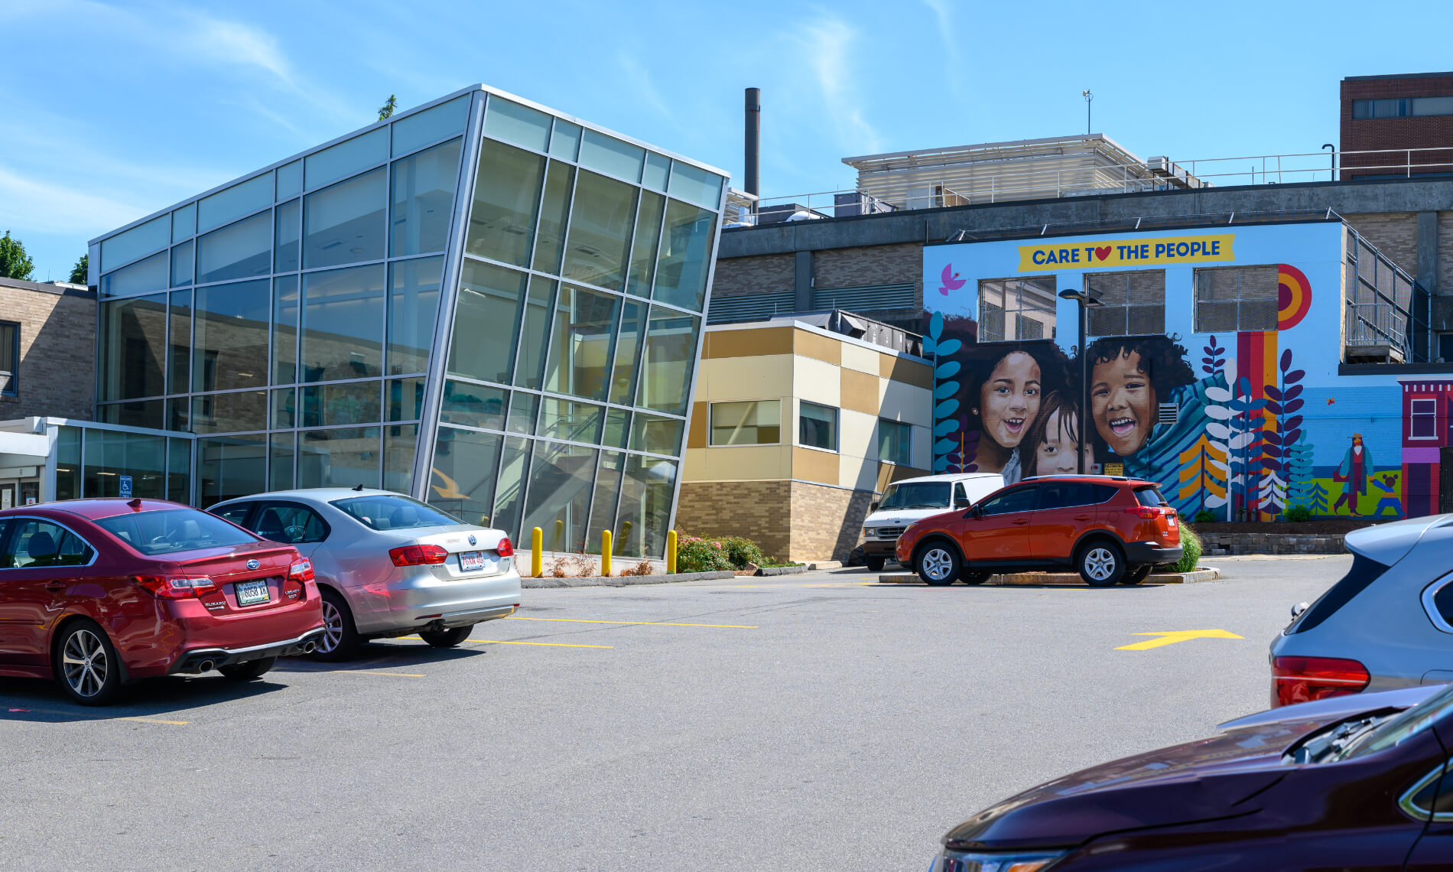
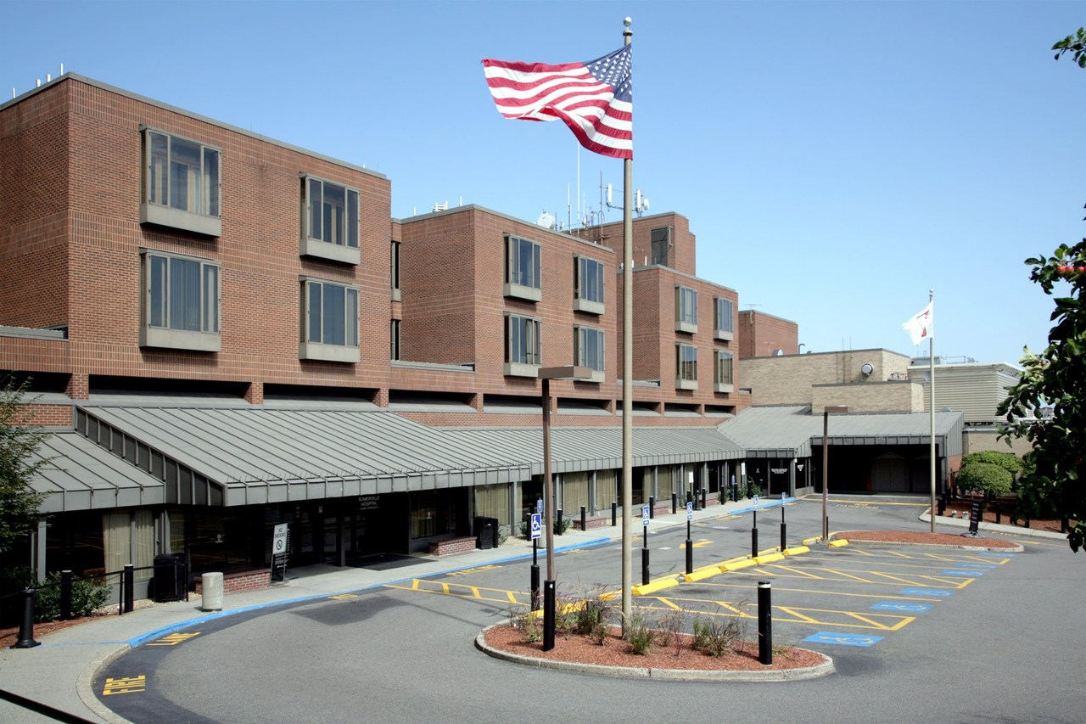
Specialized Team Treatment
for Serious Behavioral Problems
in Youth with ASD/IDD
The CHA’s NDU Model of Care
Kevin Coughlin MD
Medical Director, CHA NDU
October 2023

Slide 2
Conflicts of Interest / Disclosures
Objectives
None
Teams “Caring Together” (NDU, TEAM UP, etc)
Learning about our Patient Profiles
Learning about our Model of Care, Our Unit, Our Treatments

Slide 3
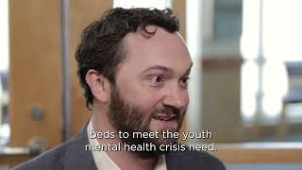

Slide 4
Teamwork Makes the Dream Work!
Psychiatrist
Board Certified Behavior Analyst
Social Work
NDU
Multidisciplinary Team
Nursing
Direct-Care Staff
Occupational Therapist
Speech Therapist
Notes:
TEAM Up is all about leveraging the therapeutic and social power of caregiving in teams
I learned a lot from my 3 years with SBCHC and TEAM UP, and am very excited to talk about what I’ve moved on to since then
This is a visual of what the team on my unit looks like these days: we focus on a very pecific type of patient profile and problem, and we use a very specific type of “helping team”
But the heart and soul of why this model works is effectively the same as whats at work with TEAM UPs approach, with Coordinated Specialty Care for psychosis, and many other newer models of care trying to push quality and equity forward

Slide 5
Psychiatry: Reputation vs. Reality!
“Well, yes, but also…”
Physician
Leader
Family Member
Lover of stories
Listener
“You’re the meds doctor, right?”
Fun Lover
Humorist
Teacher
Cat Daddy
Dancer
Healer
Advocate
Partner
Therapist
School team member
Student
Psychopharmacologist
Artist
Musician

Slide 6
Parallel Process
I am more than one part of my identity…
So are the children and families we will care for…their divergence/disability is a crucial part of their story, but not the whole story…
So are all of you…it is an amazing thing to have stepped up to the plate to do the important, challenging work of pediatric behavioral / mental health care, NDU and TEAM UP health centers alike!

Slide 7
Intellectual & Developmental Disabilities (IDD)
Organic Brain Injuries (TBI)
Exposure to Toxic Substances (e.g. Fetal Alcohol Spectrum Disorders)
Genetic and Chromosomal Disorders (Downs, Fragile X, etc)
Autism Spectrum Disorders
Intellectual Disabilities (mild, mod, severe, profound)

Slide 8
Aggression
ADHD
Genetic Syndromes
AUTISM SPECTRUM DISORDERS
Epilepsy,
Seizure Disorders,
EEG Abnormalities
Mood Disorders
Hearing Impairment
Social Anxiety
Self Injury
Genetic Syndromes
OCD
Psychosis
Cardiac Abnormalities
Restricted Interests, Movements, Behaviors
Social Comm Deficits
Gastrointestinal dysfunction
Immune
Dysfunction
Sleep disturbance
Intellectual Disabilities
Language Disorder
Motor Problems:
Apraxia
Vision Differences
Notes:
DSM 5 Criteria for ASD outline deficits that impair everyday functioning in 2 domains:
Significant impairments in social communication and interaction across contexts
Restricted, repetitive patterns of behaviors, interests, and/or activities
For someone unfamiliar with ASD, it can be difficult to imagine or picture an individual with ASD merely by reading a DSM description:
They present with a “spectrum” of impairments and can look quite different from one another
Deficits in social communication range from a child who is nonverbal to one who is highly verbal with subtle impairments in social pragmatics
Repetitive behaviors and interests extend from all-consuming stimulatory behaviors to mild preoccupations with certain topics or activities

Slide 9
"If you've met a person with autism,
you've met one person with autism.”
Dr. Stephen Shore
Autism is one word attempting to describe millions of different stories. | These are individuals with… Unique strengths and Unique difficulties grounded in Unique developmental, family, and sociocultural contexts leading to a Unique “meaning making experience” of the characteristics of their neurodivergence/disability

Slide 10
NDU Patients…
May Have…
Moderate, severe, profound cognitive/learning limitations
Minimal to no functional communication or language
Lack of recognition of emotional expression, gestures, body-language
Lack of attention-sharing behaviors, seem “in their own world”
Lack of fluid, back and forth, emotional or conversational abilities
Severe trauma histories and/or attachment disruptions
Systems involvement (DCF, DDS, DMH)
Structural healthcare and educational access inequities
Severe aggressive or disruptive behaviors
Self injurious behaviors
Mood disorders, psychosis, catatonia
Compulsive behavioral disorders
Suicidal Crisis
1. Neurodivergence/disability (ASD/IDD),
often with
2. Secondary Developmental Traumas and Environmental Stressors,
in an
3. Acute Psychiatric or Behavioral Crisis
Ages 3 - 17 yo
No strict IQ cutoff, typically +ID or severe ASD with adaptive skills impairment

Slide 11
And Still… Children with ASD/IDD:
Form attachments to parents and families, their teachers and educators, and their healthcare providers
Are members of our community with tremendous capacity for growth and change, and can learn new ways of behaving and relating
We believe in our capacity to use evidence-based therapies in a therapeutic environment to bring healing and understanding to these vulnerable populations

Slide 12
CHA Mission, Vision, Values:
Mission: To improve the health of our patients and communities.
Vision: Equity and excellence for everyone, every time.
Values: To Make a Positive Difference –
Community, Integrity, Respect, Compassion, Learning, Excellence (CIRCLE)

Slide 13
NDU Mission, Vision, Values
Person Centered: we understand that each person has a unique pathway to the present and deserves individualized care (Perry)
Narrative: we believe that words, and the stories they tell, have the power to divide or connect, denigrate or celebrate, hurt or heal. We strive to use language and narrative in ways that most inclusively support all children and their families, caregivers, and communities (Diversity Informed Tenets)
Relational, Humanistic: we highlight what makes us “the same as,” more than we underscore what makes us “different from,” the patients we work with—while maintaining an honest realism about the ways difference/divergence in this population can cause true challenges in their lives (CPS, Madsen)
Hope, Resilience, Empowerment: we offer an attitude of optimism, backed by ample evidence for treatments, strategies, and approaches that empower us towards “better”—as mutually defined by our team and each individual/family we engage with (Goepfert)
Notes:
(inspired by Bruce Perry’s “Neurosequential Model”)
(from the Diversity Informed Tenets for Working with Infants, Children, and Families)
(inspired, and in honor of, Bill Madsen’s Collaborative Therapy with Multi-Stressed Families)
(inspired, and in honor of, Eric Goepfert, MD & CHA CAP alumni, et al, 2015)

Slide 14
Foundations of Safe, Effective, Reflective, Relationships
Effective “teaming” resides at the “top of the triangle”
Reflection:
Learning
Exploring,
Building
Reflection:
Learning
Exploring,
Building
Relationship
Attachment
Safety
Relationship
Attachment
Safety
Regulation
Regulation
Notes:
I appreciate this simple pyramid visual from child psychiatrist arietta slade out of Yale
For those of you in the room that do BRANCH type work, I imagine some of these principles of safe relationships resonates with you…this is all about what we know to be true for effective trauma informed work

Slide 15
Safety
Do you feel physically safe
Is your environment safe
Do you feel pressured by administrative, scheduling, or productivity requirements?
Are there other sources of threat affecting you?
What do you need from your teammates, supervisors, and leaders to help establish safety?

Slide 16
Regulation
Are you physically calm and regulated? Or are you hungry, shut down, and irritated?
Are you in a state of fight, flight or freezing?
Are you able to attend and think clearly?
Are you rushing to do out of your own anxiety or some other pressure?
What can you do, or what do you need, to calm yourself and re-establish balance if necessary?

Slide 17
Relationship
Are you open to a relationship?
“Relationship” is the therapeutic port of entry, and kids with ASD/IDD are in relation with us, despite their neurodivergence/disability
Your humanity is the most important tool you have, regardless of your training, discipline, or guild
Safe relationships promote exploration and reflection
Trust and safety beget trust and safety

Slide 18
Overarching CHA NDU
Team Culture Supervision Structures
An NDU team member finds trust and safety in their supervisor and in their team supports
They can then become a trusted safe and secure base for a parent they are coaching about a behavior in their child
The parent can then bring a new security, trust, and safety to their relationship to their child
Individual NDU Professionals
Family/Caregiver
Patient

Slide 19
Reflection: Learning, Exploring, Building
Can you observe and listen?
Can you be curious and open and wonder why?
Can you generate hypotheses?
Can you tolerate uncertainty and not knowing?
Can you repair misunderstandings and navigate the ups and downs of relationship rupture into relationship repair (with patients and with ourselves)?

Slide 20
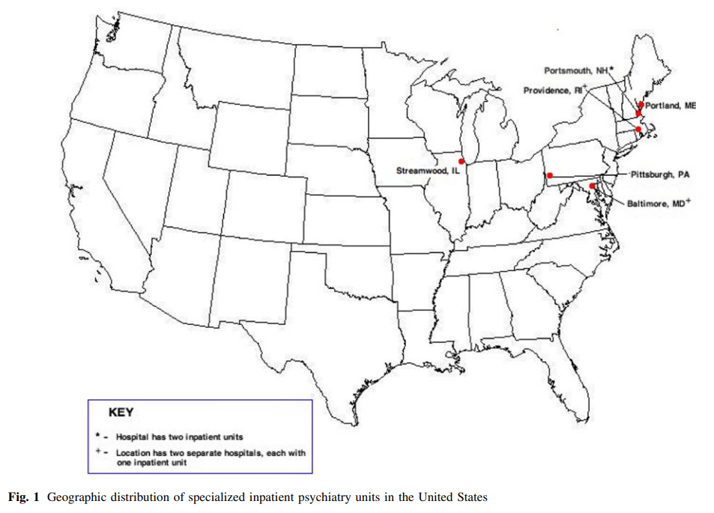
Specialized ASD/IDD Inpatient Care
Specialized Multidisciplinary Treatment (1):
Child Adolescent Psychiatrists
Board Certified Behavior Analysts (BCBAs)
Social Workers
Case Management
Direct Care Staff
Physical Therapists
Occupational Therapists
Speech Language Pathologists
Nurses
CNAs
Special Educators
Specialty Care (2):
Can be cost saving
Can shows improved outcomes
Symptom reduction
Reduced ED revisits
Westborough, MA
NDU!
New Britain, CT
Denver, CO
Cincinnati, OH
Notes:
Established, Effective, Evidence Based Model
Patients with Autism Spectrum Disorder and/or Intellectual or Developmental Disorder (hereafter referred to as ASD/IDD) show:
higher rates of mental health diagnoses than the neurotypical population (Croen et al, Hossain et al),
higher utilization rates of emergency rooms for the management of psychiatric and behavioral concerns (Kalb et al).
There is an established and effective model for specialty multidisciplinary inpatient treatment to meet the unique needs of the ASD/IDD population during a behavioral or psychiatric crisis (Wachtel and Hagopian; Romani, et al).

Slide 21
Specialized ASD/IDD Inpatient Care
Addressing Acute Safety Concerns
Treating Medical Comorbidities with Pedi Specialists
Managing Psychiatric Comorbidities
Discharge Planning to Address Long Term Concerns
Severe behavior or irritability (tantrums, aggression, property destruction)
Mental Illness
Acute Suicidality
Severe Self Injury
Constipation
Dental
Epilepsy/Seizures
Other chronic medical concerns
ADHD
Mood Disorders
Psychotic Disorders
OCD
Other disruptive/externalizing behavior disorders
Medical Follow Up
Psychiatric Follow Up
Behavioral Therapy
Speech Therapy
Occupational or Physical Therapy
In-Home Staffing Supports
Placement
Notes:
These units utilize a multidisciplinary team approach and target psychopharmacology as well as applied behavior analysis (Siegel et al., 2012)
Specialty units may result in improved outcomes relative to general psychiatric units for children with IDD (Taylor et al., 2018)

Slide 22
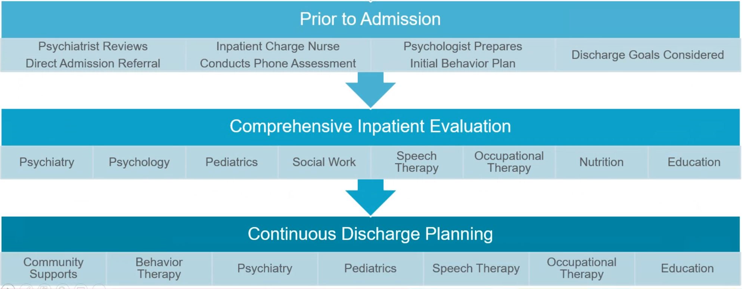

Slide 23
Operating Principles: NDU Admission “Arc”
Safety & Stabilization
Individualized “treatment and behavioral support plan” developed
Systems of data collection track progress closely
Collaboration & Coaching
What did we learn makes things “better?”
Caregivers “shadow” the plan
Caregivers “run” the plan
Step-Down
Have we accomplished:
our “treatment and behavioral support goals?” our “caregiver support and education goals?”
Appropriate safe after care plan established and executed
Notes:
Model of Care
Assess the individual’s presenting problem(s) which precipitated a crisis requiring the admission
Develop an effective multidisciplinary treatment plan which addresses the medical, psychiatric, behavioral, and social/communication components of the presenting crisis, and stabilize the individual with this plan
Engage parents, caregivers, or community supports in coaching and educational sessions to translate the success of this treatment plan back into the non-hospital setting. By learning new strategies for diminishing challenging behaviors and reinforcing more functional skills, patients and families remain safer and more successful in the community after discharge, decreasing the likelihood of readmission
Prepare for discharge by helping the family access follow up care through outpatient, in-home, or step-down levels of care

Slide 24
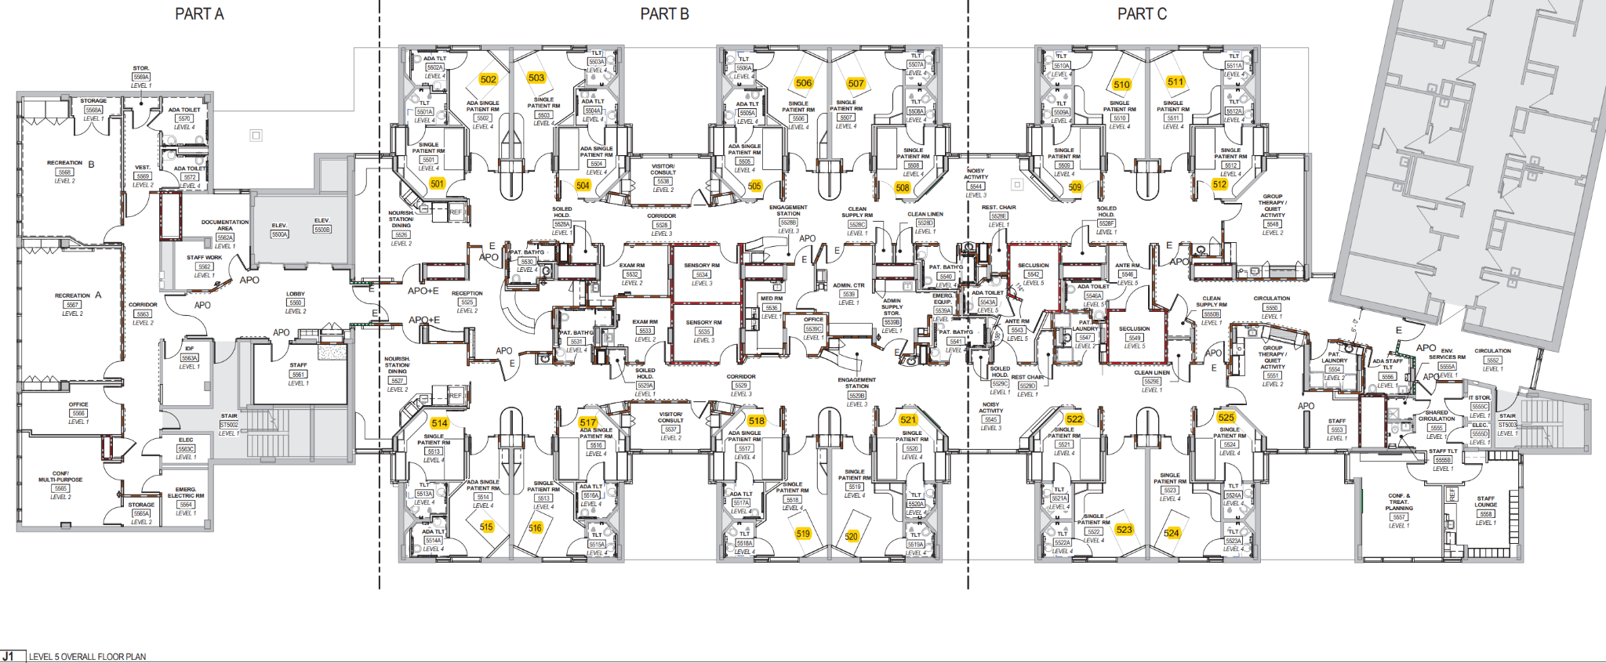
NDU Unit Layout
INDIVIDUAL PATIENT ROOMS x 8
SHARED CORE: UNIT SECRETARY, NURSE’S STATION
INDIVIDUAL: DINING, SENSORY ROOM, LINEN ROOMS
ENTRY
INDIVIDUAL PATIENT ROOMS x 8
OFF UNIT:
OT/PT REHAB GYM SPACE, INDOOR REC AREAS,
BCBA OFFICE SUITE
ON UNIT: GROUP ROOMS & CLASSROOMS,
OFF UNIT: STAFF LOUNGE AND CONF ROOMS
16 bed capacity long term (2 x 8 bed “wings”), run by 2-3 teams

Slide 26
Behavior Support Plan
Applied Behavioral Analysis (ABA)
“The science in which tactics derived from the principles of behavior are applied systematically to improve socially significant behavior, and experimentation is used to identify the variables responsible for behavior change.”
“Operant” Principles of Behavior:
Behaviors are affected by their environment
Behaviors can be strengthened or weakened by their consequences (A, B, C’s of behavior)
Behavior changes are more effective with positive responses for desired beahvior instead of negative responses for undesired behaviors
On NDU we ask…
What target behaviors can we minimize (extinguish)?
What more adaptive, prosocial, functional behaviors can make happen more (reinforce)?
How can we collaborate with caregivers/guardians to create circumstances to make this more likely to happen outside of the hospital?

Slide 27
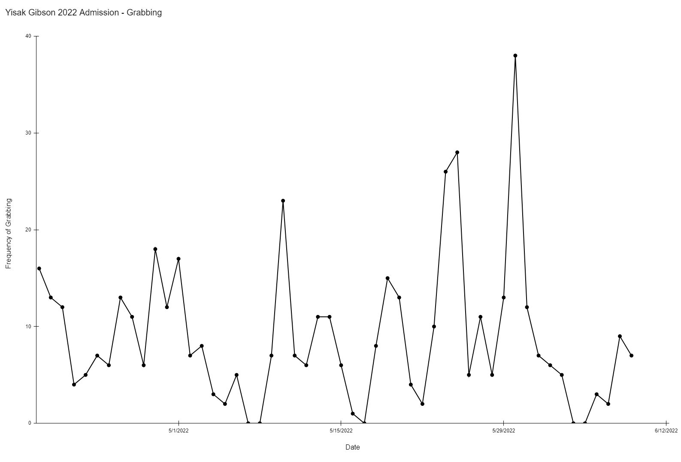
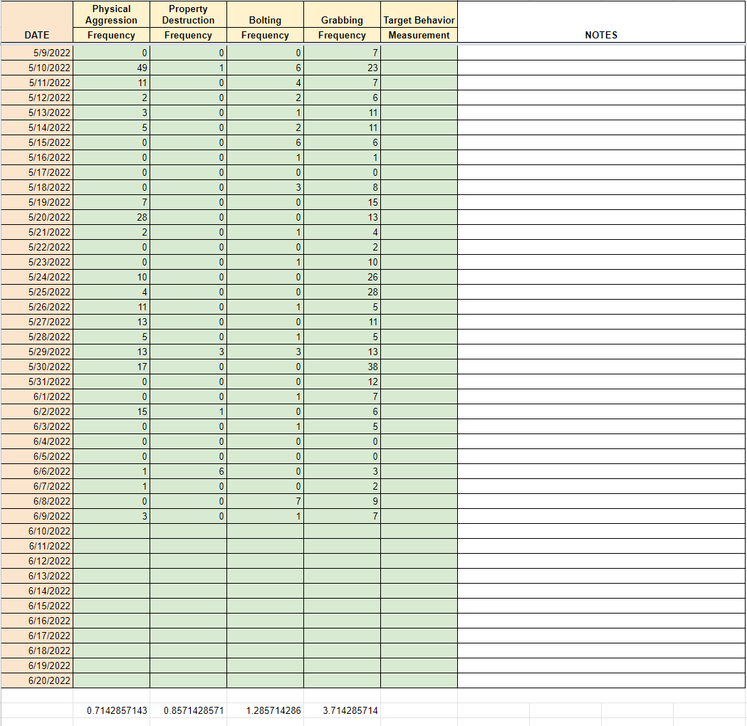
Data Driven Behavior Plans and Assessments
Milieu Counselors with certification as Registered Behavioral Technicians (RBTs) will use “patient binders” to track instances of target behavior set for reduction (PD, SIB, agg, etc) as well as adaptive/appropriate behaviors for reinforcement (functional communication, appropriate requests)
Notes:
In addition to behaviorists, nurses, milieu counselors, special educators, psychiatrists, speech language therapists and occupational and physical therapists, our team includes board certified behavioral analysts. These professionals bring the science of applied behavioral analysis and learning theory to our care model. We will use these technologies and rigorous data systems to closely track patient behaviors and monitor individualized behavior plans for effectiveness.

Slide 28
Behavior Support Plan
“Patient Binder:”
Pencil bag stores necessary materials
Pen, timers, tokens
Section dividers for the following:
Behavior Data Sheet
Behavior Support Plan
ADL Overview
Visual Supports
An initial behavior data sheet
Token economy

Slide 29
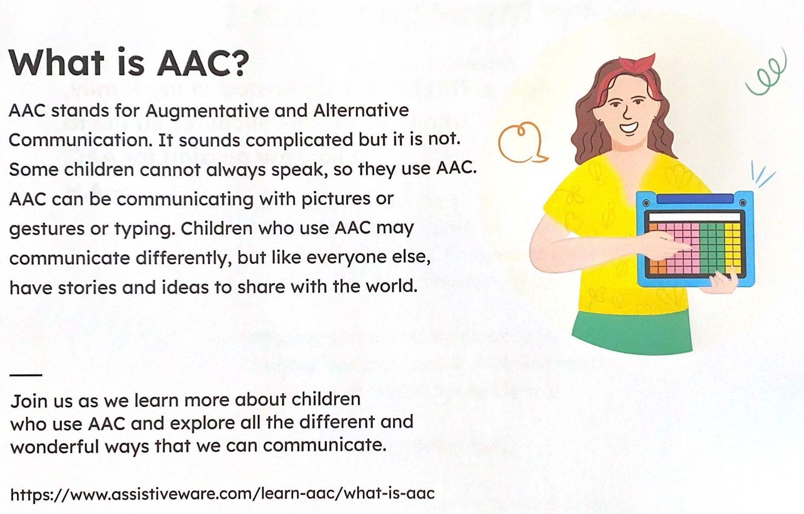
Communication Supports

Slide 30
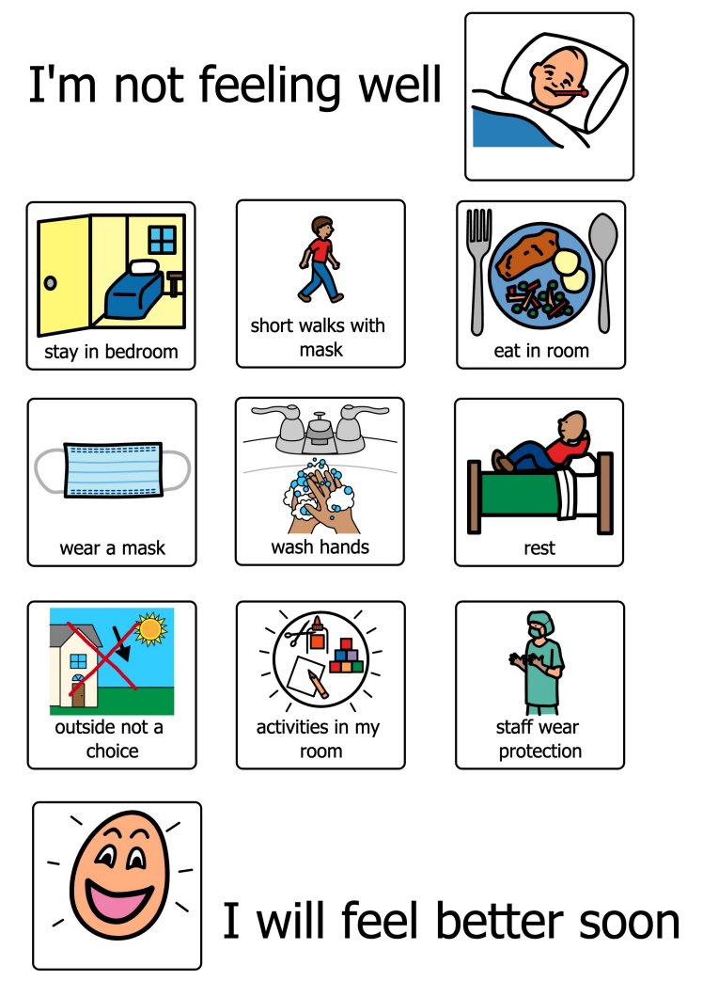
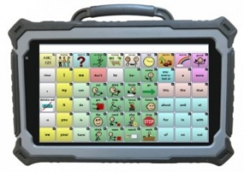
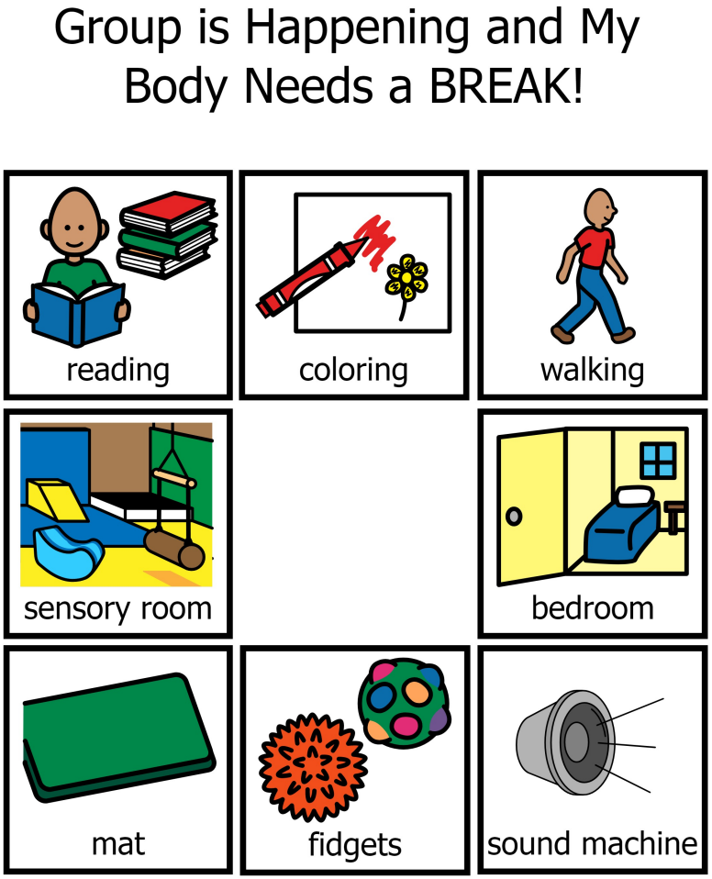
Communication Supports
All staff work to honor functional communication from our patients
Communication support tools / efforts can be guided and enhanced with expertise from speech language pathology (SLP)
Supports include, but aren’t limited to:
First then boards
Visual communication boards
Social Story Protocols
Use of speech generating devices (SGDs)

Slide 31
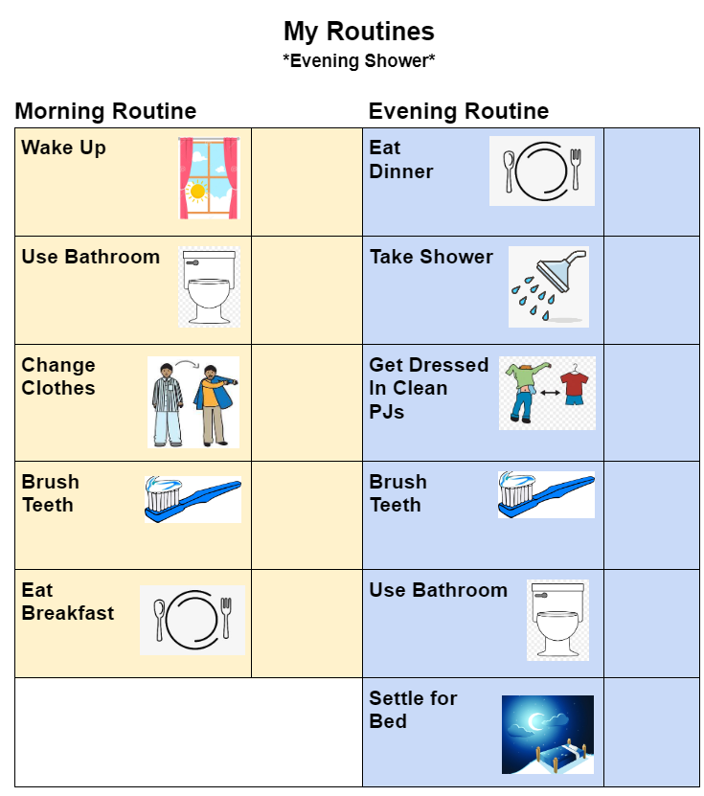
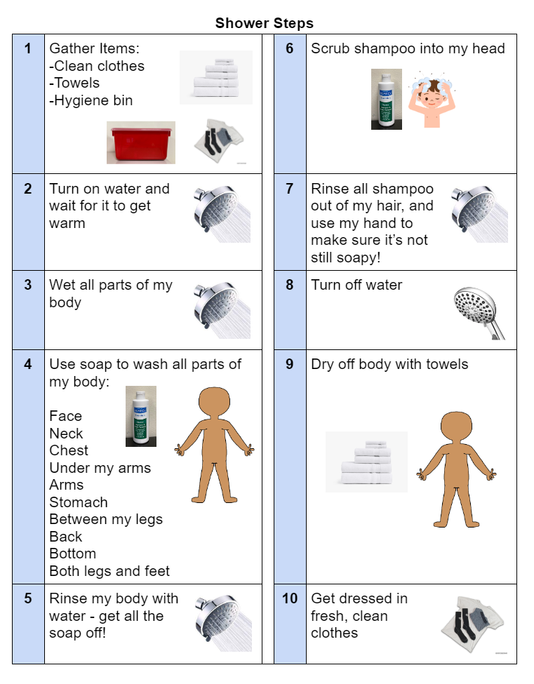
Support with Activities of Daily Living
Occupational Therapy (OT) expertise guides ADL supports with respect to:
Motor sequencing
Praxis / pragmatics
Thoroughness
Front line staff (RN, milieu counselor, registered behavioral technicians) directly provide the care

Slide 32
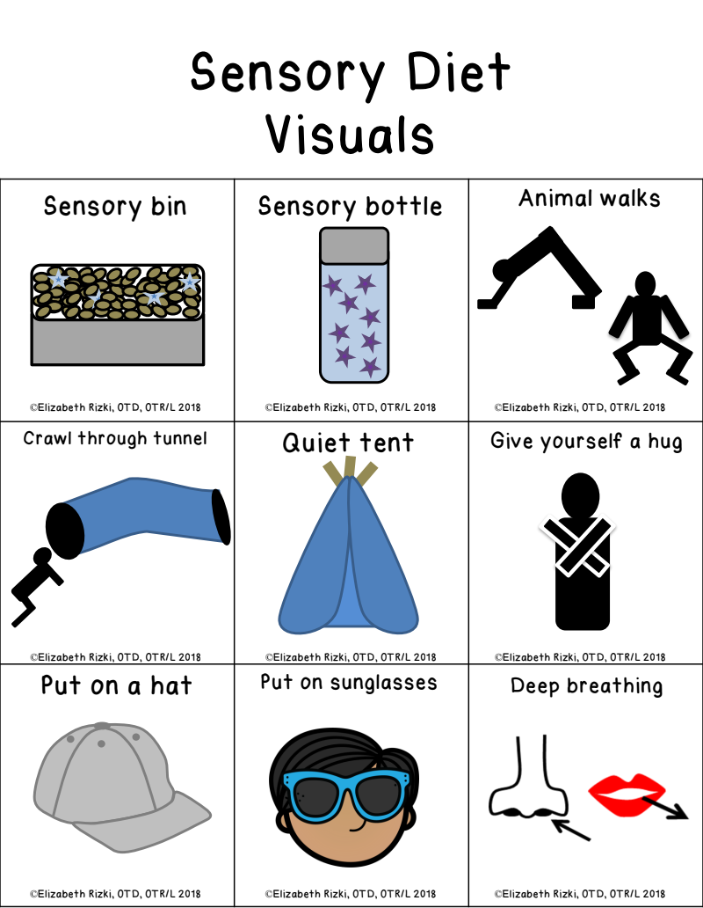
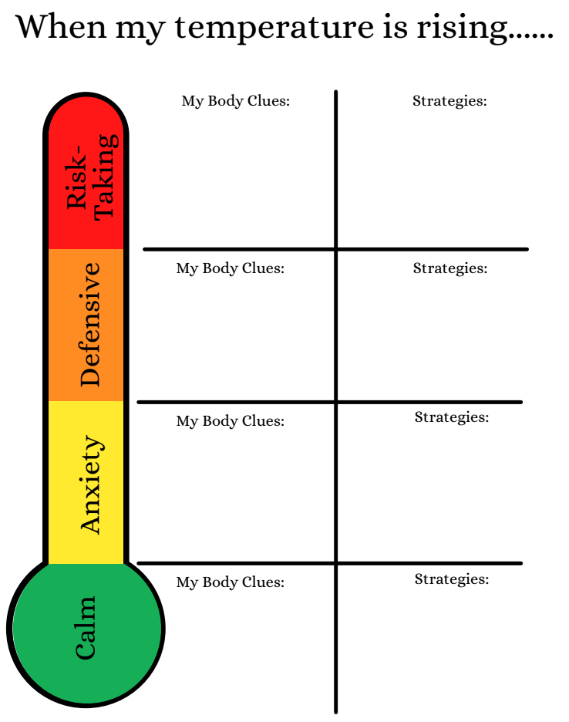
Support with Sensory Preferences and Needs
Occupational Therapy (OT) expertise guides sensory diets and sensory interventions

Slide 33
Teamwork Makes the Dream Work!
Psychiatrist
Board Certified Behavior Analyst
Social Work
NDU
Multidisciplinary Team
Nursing
Direct-Care Staff
Occupational Therapist
Speech Therapist

Slide 34
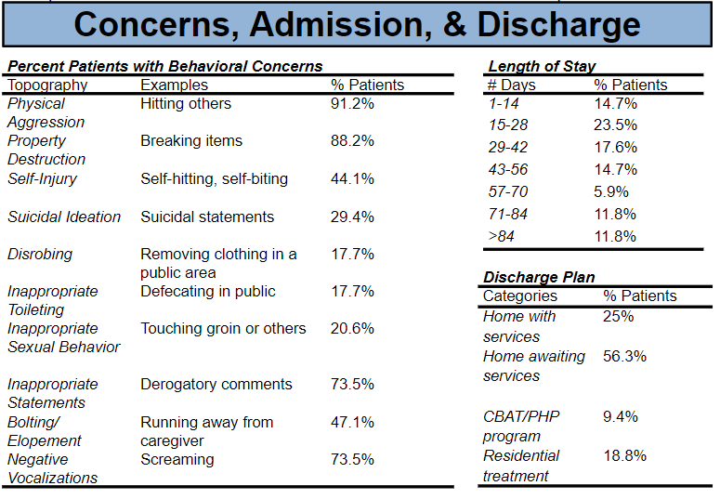
Patient Profiles and Treatment So Far…

Slide 35
Thank you!

