Slide 1
Navigating the Legal System
Michael Tumposky
Tumposky@HTLawyers.com
www.htlawyers.com
T) 617-722-8220

Slide 3
Agenda
Housing
Family
Immigration
Small Claims
Victim of a Crime
Charged with a Crime
Legal Services

Slide 4
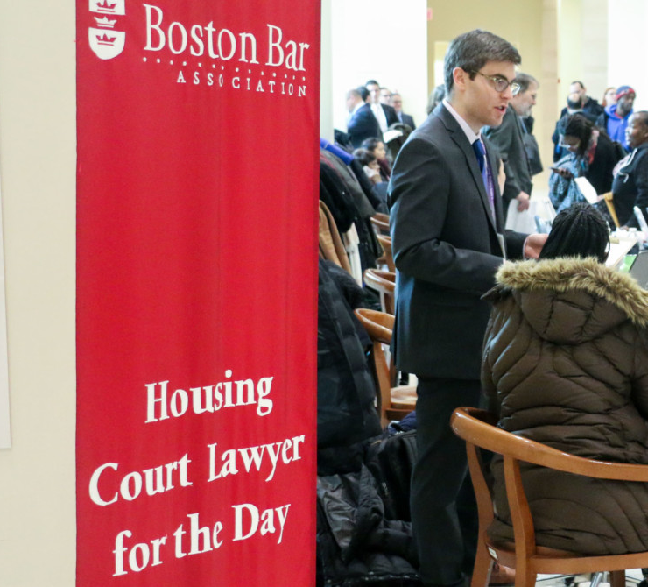
Housing
https://www.mass.gov/orgs/housing-court
https://bostonbar.org/pro-bono-public-service/bba-lawyer-for-day-program/

Slide 5
Family and children
https://www.mass.gov/orgs/probate-and-family-court

Slide 6
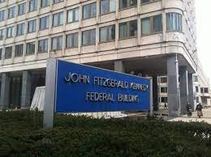
immigration
https://www.justice.gov/eoir/boston-immigration-court
https://www.miracoalition.org/

Slide 7
Small claims
https://www.mass.gov/small-claims

Slide 8
Victim OF A CRIME?
M.G.L. ch. 209A-family and intimate partner violence
M.G.L. ch. 258E-violent dispute with non-family/intimate partner
https://www.mass.gov/service-details/domestic-violence-programs-for-survivors

Slide 9
Accused of a crime
https://www.publiccounsel.net/
Me!

Slide 10
Legal Services Agencies
WilmerHale Legal Services: https://www.legalservicescenter.org/
Harvard Legal Aid: https://www.harvardlegalaid.org/
Greater Boston Legal Services: https://www.gbls.org/
Masslegalhelp: Masslegalhelp.org

Slide 11
QUESTIONS?

