Slide 1
Early Psychosis: Symptoms, Identification, and Treatment
Emily Gagen, Ph.D.
Director
Tanya Trevett, M.Ed.
Family Partner
Sarah Dreyfus
Young Adult Peer Mentor

Slide 2
Take home points
Take Home Points
Psychosis is treatable, especially when symptoms are recognized early.
Psychosis is more common than might think.
Psychosis is on a continuum and we're all on it.
You might be the first person to recognize signs of risk.
Early symptoms are often easy to dismiss.

Slide 3
Case Example
Alexis is a 17-year-old who enjoys art, gymnastics, and spending time online. She’s always struggled to connect with her peers, but that seems to have gotten worse recently. Alexis’s mom also reports that she’s always been close to her family but that lately, she’s been isolating in her room instead of spending time with them. Alexis’s mom has also reported that she’s had some trouble with hygiene; without encouragement from her mom, she will go days without showering or changing her clothes.
Over the past year, Alexis has been spending more and more time online and she talks often about conspiracy theories she hears about on YouTube. For a recent assignment, Alexis wrote a long, detailed essay explaining how the world could be a computer simulation and is overly preoccupied with the possibility that this could be true.

Slide 4
Psychosis ≠ Diagnosis
Psychosis is a set of symptoms referring to ​​difficulty telling what is real from what is not and where there is some loss of contact with consensus reality. A person may experience psychosis in the context of drug use, medical issues such as seizures or sleep deprivation, or a mental health problem such as schizophrenia, bipolar disorder, or depression.
Consensus reality: The culturally agreed-upon concepts of reality in a group of people based upon their common experiences

Slide 5
Positive Symptoms
Negative Symptoms
Added experiences:
Delusions
Inflexible false beliefs
Paranoia
Hallucinations
Hearing voices
Seeing shadows/ visions
Disorganization
Jumbled words
Behaving erratically
Reduction in:
Emotion
Showing emotion
Experiencing emotion
Social Interactions
Not talking much
Withdrawal from others
Functioning
Low motivation
Decline in self-care & functioning
Trouble with memory and attention

Slide 6
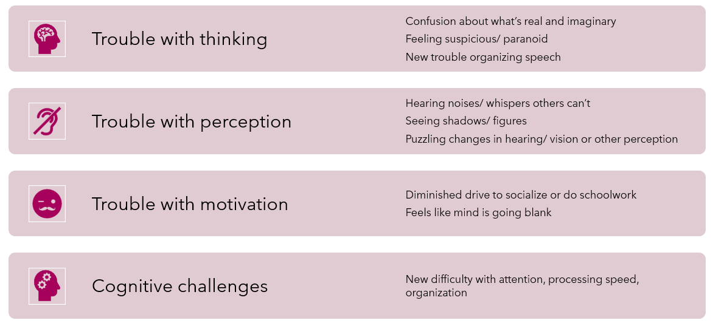

Slide 7
Continuum of Experiences
It’s not black and white, or “normal” versus “abnormal”
On a spectrum of frequency, distress, and conviction
Everyone falls somewhere on this spectrum!
“My landlord poisoned the air and I’m sure he wants to kill me.”
“I’m not sure why but I don’t trust my landlord.”
“I think my landlord might be trying to poison me.”
“I don’t like my landlord.”
Not common, very distressing
Common, not distressing
“I’m always on high alert when walking home at night.”
“I sometimes see things out of the corner of my eye when it’s dark.”
“I saw a vague figure once. I know it wasn’t real, but it freaked me out.”
“Two men wearing suits follow me everywhere I go.”

Slide 8
Prevalence
3% - Lifetime prevalence of psychotic disorders
~1% Schizophrenia
1.5% Bipolar disorder
0.5% Other (ex. substance-induced psychosis)
~21 - Average (median) age of onset
~1,100 - estimated annual incidence in MA
Rate per 100000
Schizophrenia age of onset (years)
Thorup et al., 2007

Slide 9
Psychosis is more common than you might think!
Total Population
ages 11-18
Have psychotic-like experiences
17%
Meet criteria for imminent risk syndromes
7.7%
Will develop a psychotic disorder
3%

Slide 10
Recovery From Psychosis
Recovery is very possible
We have a lot of evidence that early intervention is the best way to help people get back on track
Some people experience one episode of psychosis, some experience multiple
Goal is to reduce frequency and severity of episodes
Specialty clinics dedicated to working with youth and young adults
Notes:
Goal of early intervention is to reduce frequency & severity of recurring episodes

Slide 11
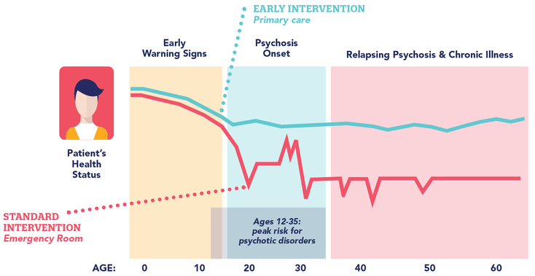
www.psychosisscreening.org

Slide 12
Treatment Delays
The average adolescent experiences psychosis for 18.7 months before treatment but WHO recommends <90 days
60% of psychotic disorders are diagnosed in crisis settings like an inpatient unit or emergency department
Delays lead to poorer outcomes
Functional and cognitive impairments
Increased risk of suicide
Loss in social/role functioning
You may be the first person to see warning signs!

Slide 13
Case Example
Alexis is a 17-year-old who enjoys art, gymnastics, and spending time online. She’s always struggled to connect with her peers, but that seems to have gotten worse recently. Alexis’s mom also reports that she’s always been close to her family but that lately, she’s been isolating in her room instead of spending time with them. Alexis’s mom has also reported that she’s had some trouble with hygiene; without encouragement from her mom, she will go days without showering or changing her clothes.
Over the past year, Alexis has been spending more and more time online and she talks often about conspiracy theories she hears about on YouTube. For a recent assignment, Alexis wrote a long, detailed essay explaining how the world could be a computer simulation and is overly preoccupied with the possibility that this could be true.

Slide 14
Psychosis
Sometimes associated with hospitalization
Clinical High Risk (CHR-p)
A constellation of symptoms involving changes in mood, thinking, and perceptions
Genetic risk / family history also a factor
A significant disruption in functioning
Most people who develop psychosis experience other mental health concerns earlier in life.
Signs of clinical high risk for psychosis can be reliably identified and increasing research supports effectiveness of early treatment.
About 10-25% will develop a psychotic disorder in next 2-3 years.

Slide 15
Signs To Consider
Drop in grades/work performance
Trouble concentrating
Decline in self-care
Social withdrawal
Unusual or intense ideas
Suspiciousness
Sensitivity to sights/sounds
Feeling like your mind is “playing tricks on you”
A close relative with serious mental illness (especially psychosis)
Borrowed from Dr. Michelle Friedman-Yakoobian

Slide 16
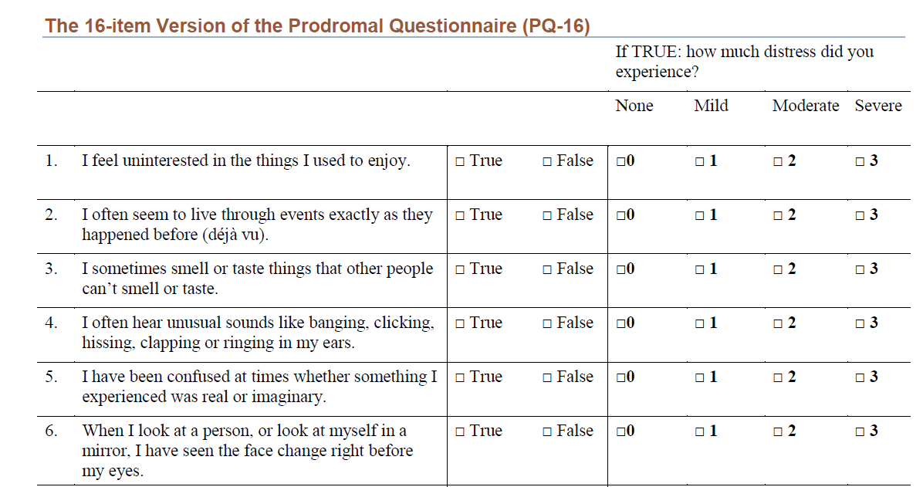
https://www.psychosisscreening.org/asking-about-psychosis.html

Slide 17
Assessing Risk for Harm
Psychotic symptoms by themselves do not necessarily indicate a safety concern!
When to consider emergency services:
Active or difficult-to-manage suicidal/violent thoughts or impulses
Current or recent command hallucinations to hurt themselves or someone else (assess degree of risk)
Significantly out of touch with reality for more than several minutes at a time
Behavior is severely disorganized or dangerous.
Gather details with existing assessment tools:
Suicidality: SAFE-T, CSSRS, MCPAP Screening Resources
Violence: V-RISK 10, Structured Assessment of Violence Risk in Youth (SAVRY)
https://www.psychosisscreening.org/path-4-same-day-assessment.html

Slide 18
You Can Relate!
Although symptoms of psychosis may seem difficult to understand, they are often related to underlying anxieties.
The goal is not to “fix” people or convince them out of their beliefs, but rather to make sure they feel listened to and supported.
Listen for the emotions that the person is experiencing (confused, afraid, alone).

Slide 19
Some Questions To Ask
Do you ever feel that your mind is playing tricks on you?
Are you ever confused about whether something you experienced is real or imaginary?
Have you ever felt that you are not in control of your own ideas or thoughts?
Do you find that you’re more sensitive to sounds? Or hear things other people don’t hear?
Are you more sensitive to light? Do you ever see things out of the corner of your eyes?
Are you having more trouble understanding what people are saying? Or getting your point across?

Slide 20
Follow Up Questions
What is the experience like?
How is it impacting them?
How often does it happen?
Has it changed over time (gotten better
or worse)?

Slide 21
An Example
“I think my house is inhabited by spirits.”
What is the EXPERIENCE like?
What do you make of it?
Do other people in your family/culture believe this too?
Is it IMPACTING them?
Do you ever do anything differently as a result of that thought?
Is it RECURRING or PROGRESSING?
How often are you having that thought?
When did it start?
How certain are you about that thought, from 0 to 100?
Is there any other explanation? Any chance this is not really happening?
https://www.psychosisscreening.org/follow-up-questions.html

Slide 22
How To Respond
With hope and optimism!
Thank you for sharing this with me.
This is more common than you think.
Let’s talk about how I can support you.

Slide 23
How To Provide Feedback
Consider the Context
What is your rapport like with the person/their family?
What do you know about their background, culture, and past experiences that might influence your feedback?
What do they already know about psychosis?
Decide Who To Include
Do they want to involve their family?
Any concerns about their maturity level or cognitive functioning that would make it helpful to include family?
What is their relationship with their family like?
Notes:
https://mhttcnetwork.org/sites/mhttc/files/2022-09/MHTTC-Clinical%20Brief-Aug-2022-v4.pdf

Slide 24
The INSPIRES Model
Individualize
Normalizing, non-stigmatizing
Setting
Person-centered perspective
Information
Reassure, Repeat, & Respond
Empathize & Empower
Individualize your approach
Normalize psychosis as a type of human experience; address stigma
Plan ahead to have a safe setting & ensure confidentiality
Respect the person/family’s values, preferences, and autonomy
Provide accurate & comprehensive information
Take your time; check in about their questions & worries
Empathize with their reactions & empower them in seeking help
Strategy and next steps
Plan for next steps
Keshavan, M., Davis, B., Friedman-Yakoobian, M., & Mesholam-Gately, R. (2022). What is my diagnosis, Doc?: Discussing psychosis diagnosis with patients and families. Schizophrenia Research. 239. 92-94. 10.1016/j.schres.2021.10.009.
Notes:
https://mhttcnetwork.org/sites/mhttc/files/2022-09/MHTTC-Clinical%20Brief-Aug-2022-v4.pdf

Slide 25
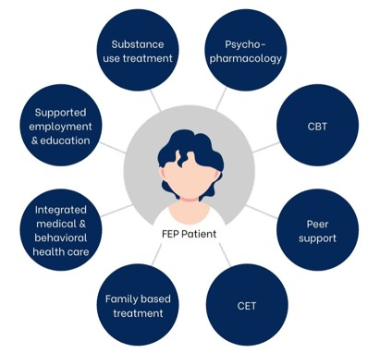
Coordinated Specialty Care
Integrated specialized treatment
Individual and family therapy
Psychiatry
Vocational and educational support
Goal: to prevent worsening of symptoms and functioning
CHR-p clinics vs. FEP clinics
Not sure? Call M-PATH!

Slide 26
Massachusetts Psychosis Access and Triage Hub
A free referral and triage hub for clinical high risk and early psychosis services in Massachusetts (under age 35)
Consultation for medical and mental health professionals
Referral support for clients and their loved ones
(617) 927-9809
mpath@brooklinecenter.org
www.mpathcares.org

Slide 27
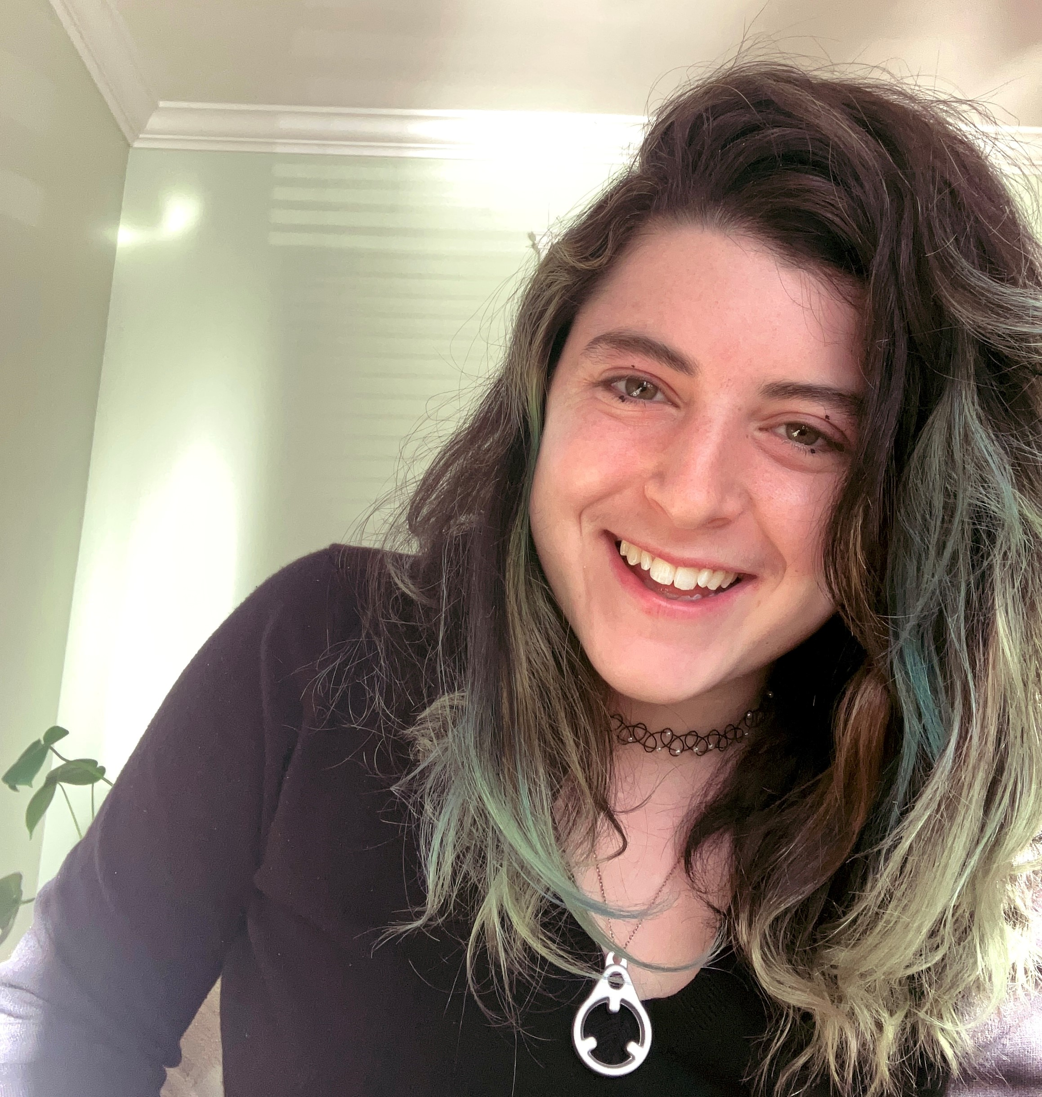
Our Team
Emily Gagen, PhD
Director
Rebecca Wlcek, BA
Program Coordinator
Charlene Flynn, LMHC
Clinician/Care Coordinator
Tanya Trevett, M.Ed.
Family Partner
Sarah Dreyfus
Young Adult
Peer Mentor
Henry White, MD
Founder, Lead Consultant
Jessica Stern, MD
Co-Founder,
Psychiatric Consultant
Amanda Weber, PhD
Psychological Consultant
Emily Kline, PhD
Consultant
James Green, BA
Data Coordinator

Slide 28
How We Can Help
For Providers
For Clients & Families
Diagnostic consultation and education regarding risk for psychosis and early psychosis
Ongoing consultation for long-term work with youth and families with early psychosis
Facilitation of referral to specialized psychosis treatment
Psychosis-informed care
Triage to help determine which services would be the best fit
Navigation to coordinated specialty care, including first episode or clinical high risk for psychosis programs
Care coordination and support throughout the referral process
Peer and family support and education

Slide 29
Resources for Clinicians
M-PATH: www.mpathcares.org
MAPNET: www.mapnet.online
Training Toolkit: www.mapnet.online/psychosis-training-toolkit
All past trainings: www.mapnet.online/past-events
Common Comorbidities Series
Substance Use: https://www.mapnet.online/events/2022/6/3/early-psychosis-and-substance-use-key-skills-for-recovery
OCD: https://www.mapnet.online/events/2022/2/25/ocd-psychosis-or-both
Trauma: https://www.mapnet.online/events/2022/10/21/treating-youth-with-early-psychosis-and-trauma-related-disorders
Suicidality: https://www.mapnet.online/events/2022/6/17/harm-risk-assessment-in-clinical-practice
Autism Spectrum: https://www.mapnet.online/events/2023/3/24/diagnosis-and-treatment-of-psychosis-in-autism-spectrum-disorder

Slide 30
Resources for Young People
SAMHSA Info Sheet
https://www.samhsa.gov/resource/ebp/understanding-first-episode-psychosis-young-adult-get-facts
Peer Support Groups
McLean WellSpace
Tempo Young Adult Resource Center
Hearing Voices Networks
Depression and Bipolar Support Alliance (DBSA) of Boston
Recommended Content Creators
Living Well with Schizophrenia
Schizophrenic Hippie
SchizophrenicNYC

Slide 31
Resources for Families
Living Well With Schizophrenia: Accepting Your Loved One’s Mental Illness: youtube.com/watch?v=aaqSM_WLk1w
Books
“You Are Not Alone: The NAMI Guide to Navigating Mental Health” by Ken Duckworth
“The School of Hard Talks: How to Have Real Conversations with Your (Almost Grown) Kids” by Emily Kline
“I Am Not Sick, I Don’t Need Help! How to Help Someone with Mental Illness Accept Treatment” by Xavier Amador
The School of Hard Talks Online: handholdma.org/what-can-i-do/the-school-of-hard-talks-online-lessons-from-motivational-interviewing-for-everyday-families
CBHI Knowledge Center: handholdma.org
Notes:
Resources for families from cedar website: https://cedarclinic.org/for-families-2/
Respecting autonomy

