Slide 1
The Importance Of Representation in children’s literature
By Educator and author
Gina Paul

Slide 2
About me
Born in Haiti
Moved with my family to the United States at 10 years old
Attended school in New York
Currently working as a NYC special education teacher

Slide 3
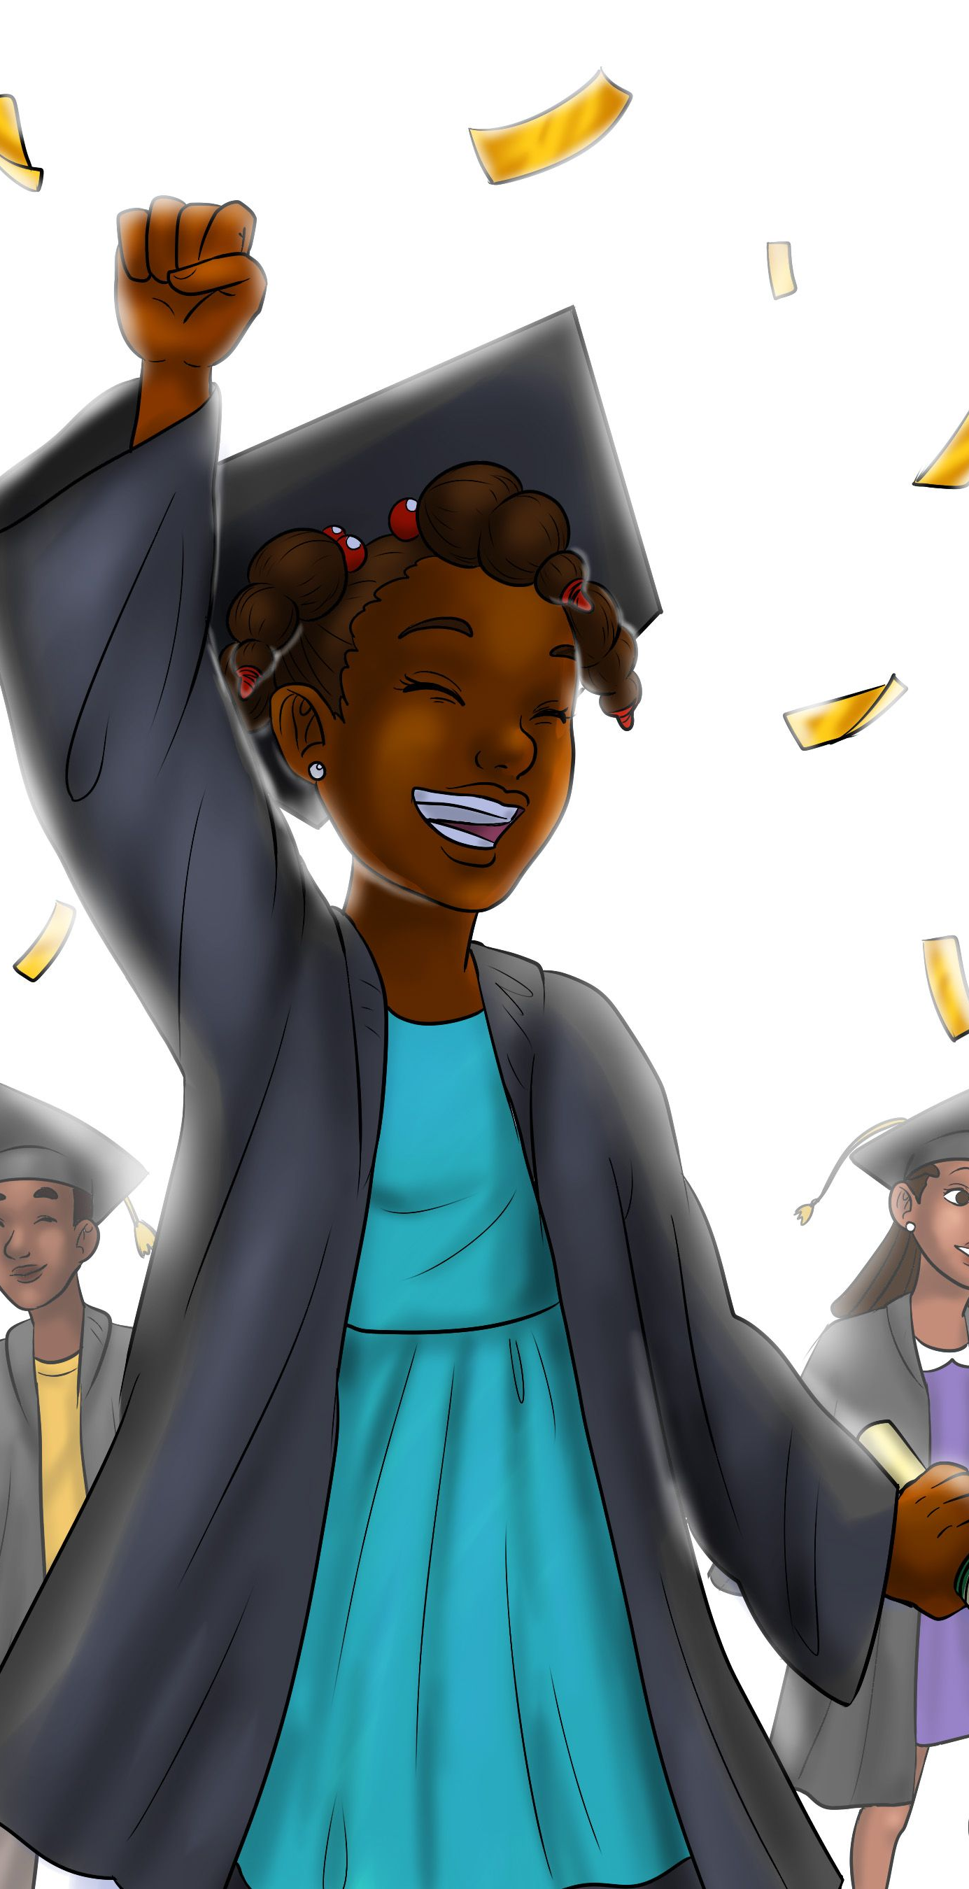
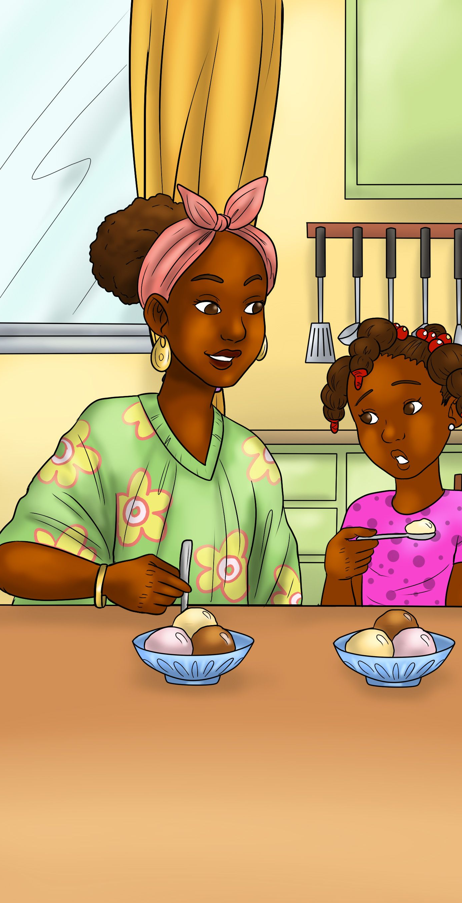
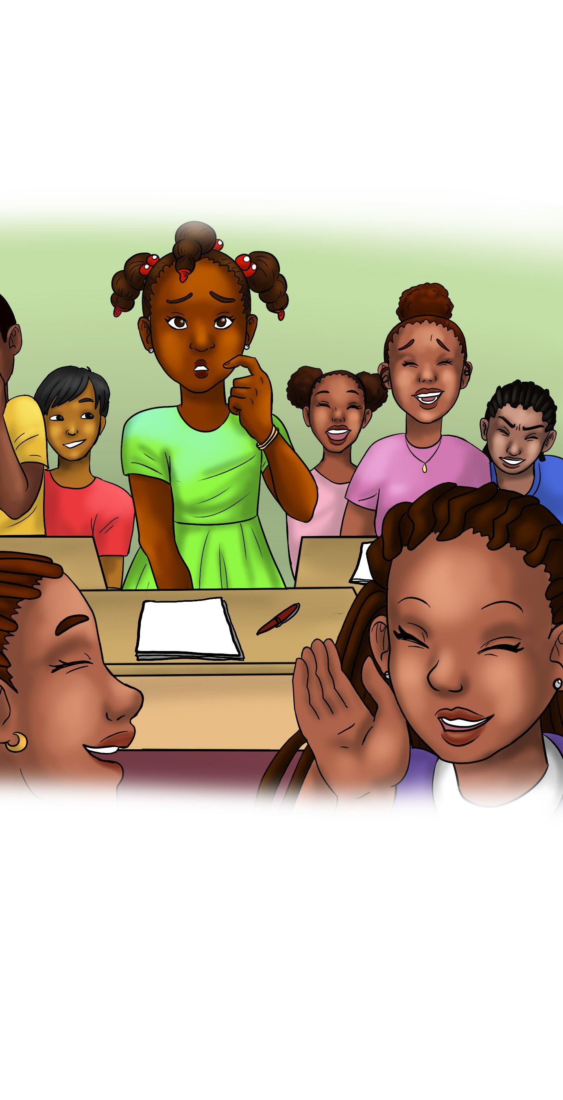
How my book came about
Personal experiences
It took five years to write
Nine months to publish

Slide 4
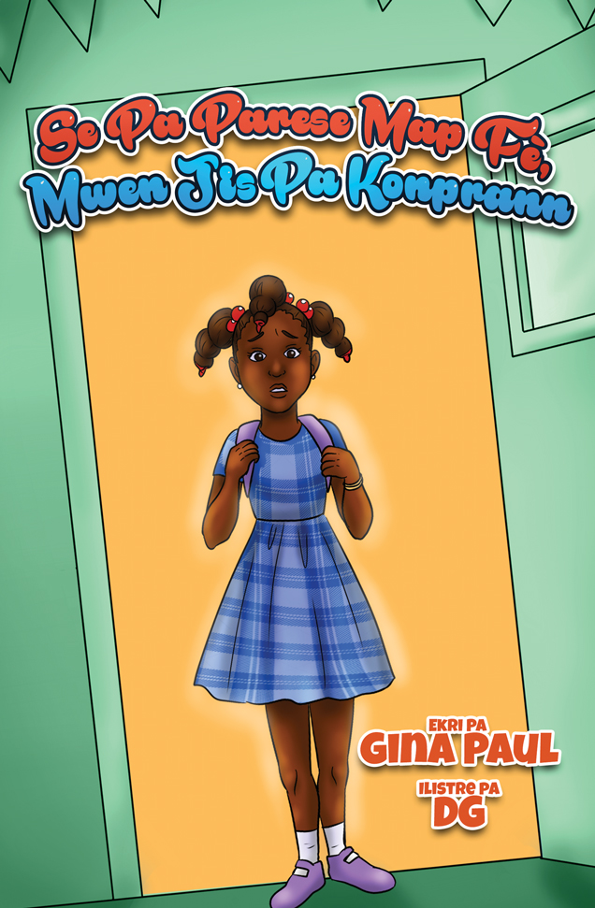
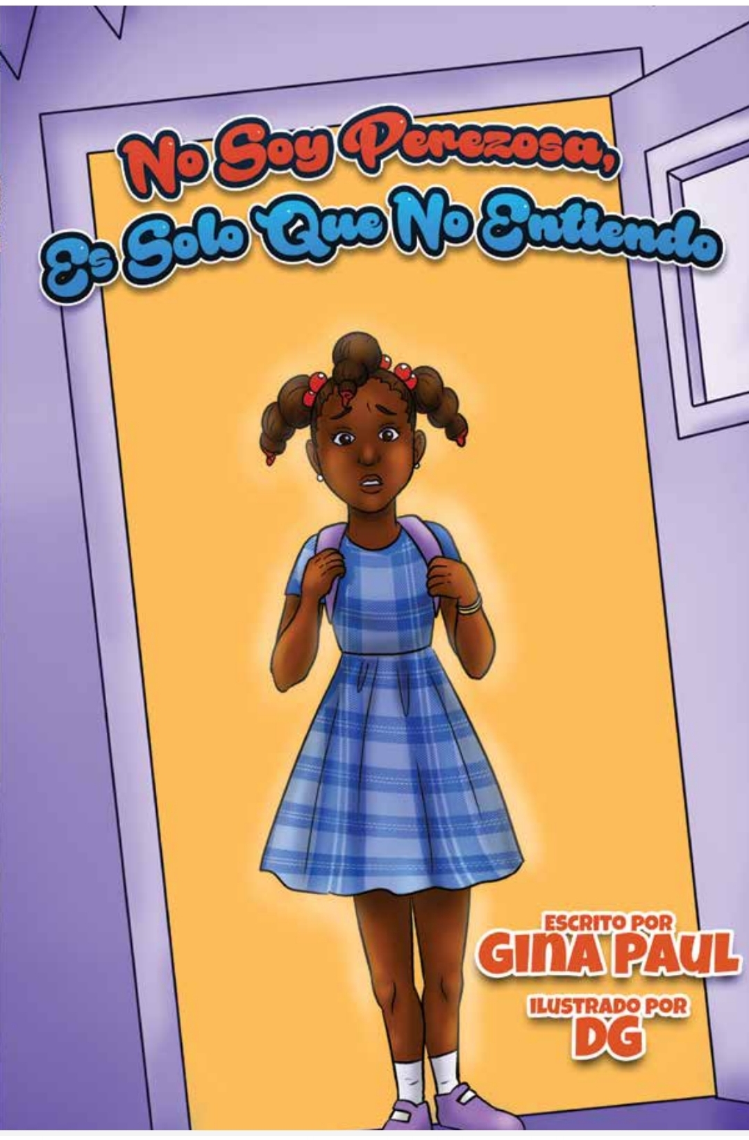
Book: I am not being lazy, I just don’t understand
English
Haitian Creole
Spanish (Coming soon)

Slide 5
Why representation matter
Helps children to know that they matter and are seen
It is a way for children to make sense of themselves
Social awareness
Positive view of their race, culture, etc.
Understand that they are capable

Slide 6
What kids can learn from the book
Empathy
Social awareness / social skills
Emotional awareness
Learning responsible decision making
Helping children to learn who they are and what they believe in
Self-management
Positive relationship skills
Create opportunity to bridge cultural gaps in schools and neighborhoods
How to be good citizens

Slide 7
Q & A

Slide 8
Where you can find my books
Amazon
IngramSpark
Walmart (online)
Target (online)
Barnes & Noble (online)
AbeBooks

Slide 9
My information
Email address: gina.paul.author@gmail.com
Social media platform:
Instagram
Facebook
LinkedIn
Twitter

