Slide 1
Gender Affirming Integrative Care in Pediatrics:
Creating a supportive care community in time of assault of trans youth-rights

Slide 2
Grant Pike, MSW, LICSW DSW candidate Simmons University Clinical Social Worker Presenter, Consultant, Writer grantpike@shiningoak.org 617-398-7080

Slide 3
Today’s Training Includes:
Goal:
Participants will go through LGBTQ+ training to increase knowledge and awareness around this population
Objective:
To bring a deeper understanding to clinical/behavioral health setting
Purpose:
To give participants a better understanding of LGBTQ+ identities and bring this into patient care

Slide 4
Gender/Sexuality 101
Facts and Stats
Gender-Affirming/Patient centered Care
Organizational Inclusivity
5 ways to support trans youth
Outline for Training

Slide 5
Gender and Sexuality 101

Slide 7
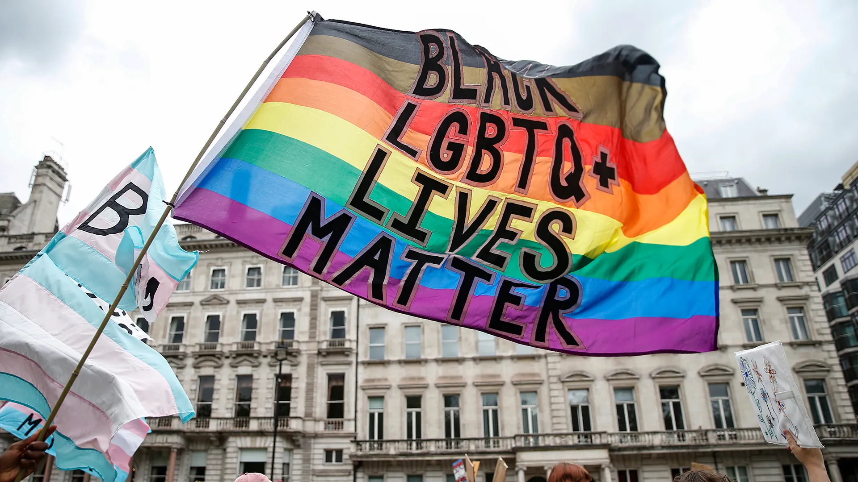

Slide 8
Heteronormativity—The assumption, in individuals or in institutions, that everyone is heterosexual, and that heterosexuality is superior to homosexuality and bisexuality.
Heterosexism – Prejudice against individuals and groups who display non-heterosexual behaviors or identities, combined with the majority power to impose such prejudice. Usually used to the advantage of the group in power. Any attitude, action, or practice – backed by institutional power – that subordinates people because of their sexual orientation.
Heterosexual Privilege –Those benefits derived automatically by being heterosexual that are denied to homosexuals and bisexuals. Also, the benefits homosexuals and bisexuals receive as a result of claiming heterosexual identity or denying homosexual or bisexual identity.
Green, Eli & Peterson, Eric (2003) LGBT Resource Center, UC Riverside. https://lgbtrc.usc.edu/files/2015/05/LGBT-Terminology.pdf

Slide 9
https://medium.com/@MugdhoSapiens/gender-diversity-paradoxes-and-bangladesh-6c6847bd2cd5

Slide 10
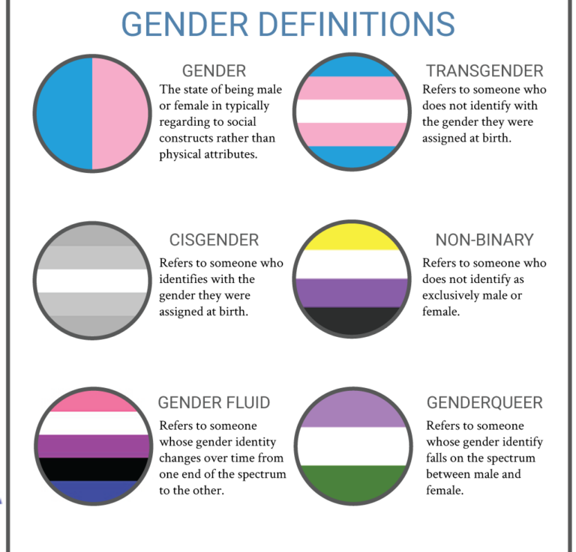

Slide 11
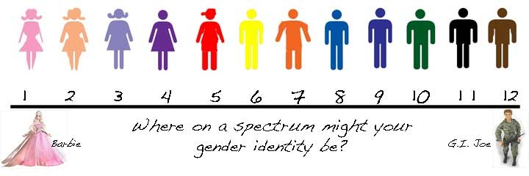
Gender and Identity and Sexuality. (2020) https://sites.google.com/site/roadshealthandservice/gender-and-identity-and-sexuality

Slide 13
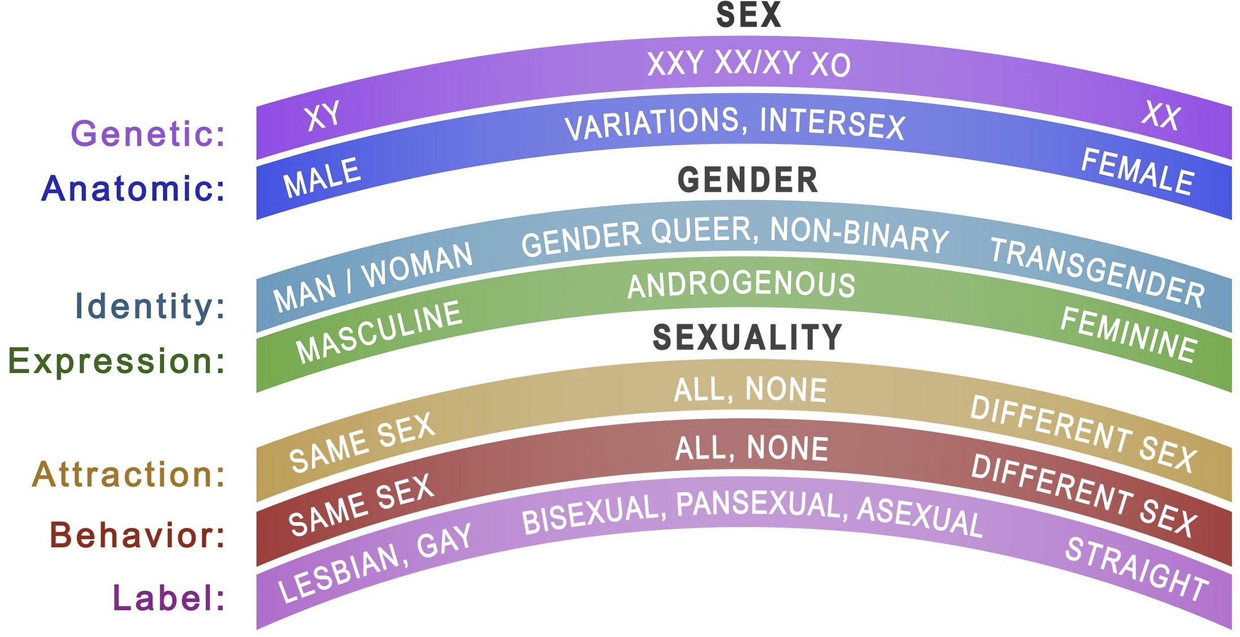
https://www.advancesinpediatrics.org/article/S0065-3101%2818%2930003-3/fulltext

Slide 14
Facts and Stats

Slide 15
Gender/Sexuality Minority Stress Model
Stigma and Oppression
Minority Stress:
Individual
Interpersonal
Structural
Gender/Sexual Minorities:
LGBTQ+ identified
Adverse Mental Health & Health Disparities
Reisner, S.L. (2021)

Slide 18
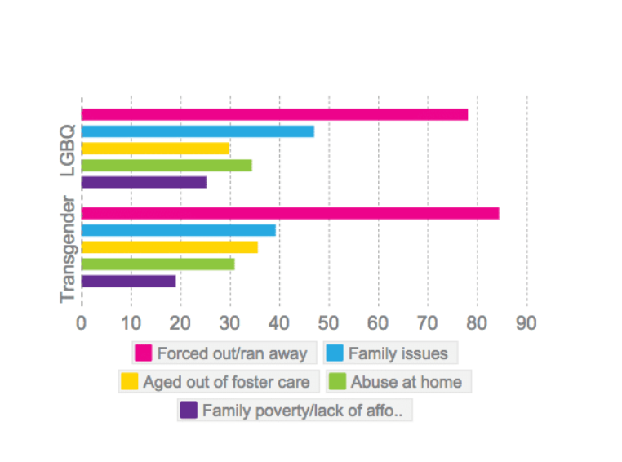

Slide 21
Facts and Stats

Slide 22
Facts and Stats

Slide 23
LGBTQ+ Patient-Centered Care

Slide 24
Best Practices | Examples | Core Care Principles
Avoid specific gender markers | “How may I help you today?” | Responsiveness
Politely ask if you are unsure about a patient’s preferred name or pronoun | “I want to be respectful; how would you like to be address” or” What is your preferred name and pronoun?” | Open-Mindedness
Ask respectfully about names | “Could your chart be under another name” Avoid: “What is your legal name? What is your real name”” | Communication
Did you goof on this? Be compassionate and apologize | “I am sorry for using the wrong pronoun. I did not mean to be disrespectful” | Accountability
Gender neutral language | Use “they*” instead of “he” or “she” | Reliability
Only ask for information that is required | Ask yourself” What di I want to know” What do I need to know” How can I can in a sensitive way” | Respect
Grammar policing other persons use of words diminishes the dignity and worth of the person. There is a long historical account for use of singular “they as well”.
*Ansley, L. (2012) American Historical Association

Slide 25
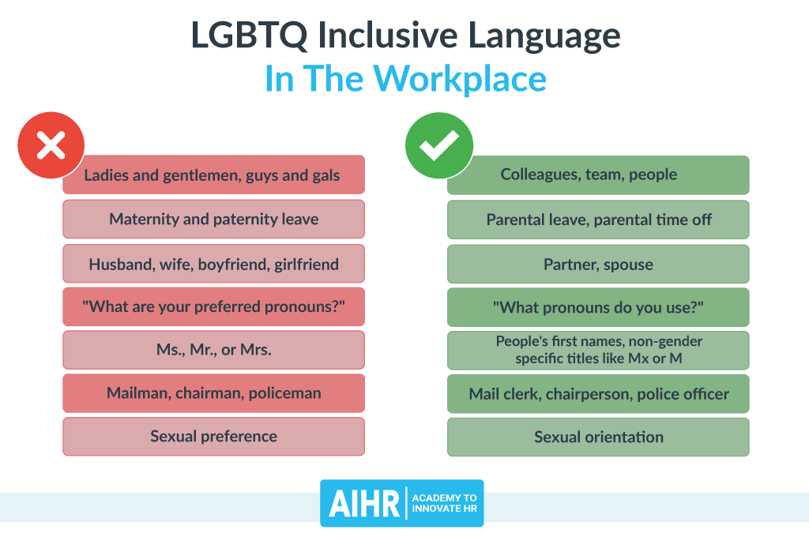
https://www.aihr.com/blog/lgbtq-inclusive-language-in-the-workplace/

Slide 26
Organizational support for staff
Create and follow a protocol for noting preferred names, pronouns, mail, voice message instructions
Have clear lines of referral for questions
Appoint a staff person responsible for providing guidance, assisting with procedures, offering referrals, fielding complaints
Ongoing training and retraining of staff
Annual transgender competency trainings and boundary trainings (e.g., know what/ what not to ask about)
Train new staff on protocols within one month of hire
Accountability for homophobic/transphobic responses
Advanced trainings for staff involved in direct care with expectations of continuing education on transgender issues

Slide 27
Gathering Patient Data
Patient intake forms
Assigned sex at birth
Current gender identity
EMR flags indicating trans patients
Ask for a patient’s last name and date of birth when unsure of gender or preferred name when checking in and ask what would they like to me called, if this is not already noted on the intake form.
Providers can ask during visit
“Because many people are affected by gender issues, I ask patients if they have any relevant concerns. Anything you say will be kept confidential. If this topic isn’t relevant to you, tell me and I will move on.”
http://www.lgbthealtheducation.org/wp-content/uploads/policy_brief_why_gather.pdf

Slide 28
What can you do in your work?
Be non-judgmental, open, and professional. Provide client-centered care (e.g., meet the person “where they are”)
Be an ally. Educate yourself so you are LGBTQ+ friendly in your field of expertise. Working with colleagues: “See something, say something.”
Denoting inclusive materials, such as a pride flag, is a clear way to show LGBTQ+ patients we are accepting and honoring. The signifier of the pride flag is a non-verbal way to let LGBTQ+ patients know they are welcomed.

Slide 29
5 Ways to Support

Slide 30
Effective Trans/Nonbinary Youth Support
Supportive of Trans Youth
Listen
Empathize
Trust
Curiosity
Uplift
Pike, G. (2022) Five Ways To Support Youth Transgender Youth. Options Magazine, 2022.

Slide 31
Listen
Listening to children is the best way to support them. For Queer, Trans, and Nonbinary children and youth the act of listening to the words they are sharing with you is a powerful thing. When we listen, we validate, and we can learn what is going on.
Children have a lot to speak about and it is wonderful when we honor Queer youth.

Slide 32
Empathize
Queer and Transgender youth need us to empathize with them and not push them away. So, remember that we too were once that age. Wouldn’t it have been nice to have someone to see that we are worthy human beings capable of knowing who we were when we were that age?
Transgender children need empathy, which is a powerful tool we can so easily give.

Slide 33
Trust
Trust that children know who they are. When a Transgender or Nonbinary youth tells you who they are, believe them. When trust is established by a supportive person Transgender children can thrive and feel that they are important.
To be a trustworthy supportive person requires little effort beyond authenticity and being present for a Transgender child.

Slide 34
Curiosity
Educate yourself on pronouns, new ways to express oneself, and what interests' Transgender youth. As we move into a more inclusive LGBTQ community, we change, grow, and adapt. With increased visibility brings increased insight, knowledge, and new ideas.
If you don’t fully know what a Transgender/Nonbinary youth is saying about their identity, get curious and ask with an open heart. You may learn a lot from them.

Slide 35
Uplift
When we become older, we can act as role models and mentors for younger generations. We can easily forget that since we missed out on a generation of elders lost to the AIDS epidemic. Advocating, lifting youth voices, and standing with youth is important.
The role of an ally is never to stand in front of others, but next to them so we can increase their voice.

Slide 36
Better Supporter of Transgender Youth
Five simple ways to be helpful allies. That is what we are saying when we support others whose voices are marginalized. We become allies with them and want to help. We are in challenging times right now with the assault on transgender youth surging in the nation, including threats to gender-affirming medicine in our nearby state. In my time working with transgender children, I have come to know how simple these five things can be to change their lives.
Listen, empathize, trust, stay curious, and uplift – these are our best tools for mental and emotional well-being.

Slide 38
Thank you
Questions, comments, concerns?
Please reach out to me with any pressing questions you may have at:
grantpike@shiningoak.org

Slide 39
Citations
Ansley, L. (2020). The magazine of the American Historical Association/ “Singular They: Nonbinary Language in the Historical Community”. https://www.historians.org/publications-and-directories/perspectives-on-history/april-2020/singular-they-nonbinary-language-in-the-historical-community
Feldman, J. "Preventive Care of the Transgendered Patient: An Evidence-Based Approach" in Principles of Transgender Medicine and Surgery, Ettner, R., Monstrey, S., and Eyler, A.E. (Eds). New York: The Haworth Press; 2007.
Fenway Health’s Trans Health Program (2021) http://www.fenwayhealth.org/site/PageServer?pagename=FCHC_srv_services_t rans
Fenway Institute Policy Brief (2021) \http://www.lgbthealtheducation.org/wp-content/uploads/policy_brief_why_gather.pdf
Green, Eli & Peterson, Eric (2003) LGBT Resource Center, UC Riverside. https://lgbtrc.usc.edu/files/2015/05/LGBT-Terminology.pdf
J Sex Marital Ther. (2019);45(3):218-229. doi: 10.1080/0092623X.2018.1518885. Epub 2018 Dec 22
History of Transgender in DSM- Drescher, J., Cohen-Kettenis, P., & Winter, S. (2012). Minding the body: Situating gender identity diagnoses in the ICD-11. International Review of Psychiatry, 24(6), 568-577.
Lev A. (2004). Transgender Emergence: Therapeutic guidelines for working with gender variant people and their families. NY: Haworth Press.
National Institute for Health Care Management (NIHCM) Foundation (2020) Lifelong Health Disparities in LGBTQ+ Communities. https://nihcm.org/publications/lifelong-health-disparities-in-lgbtq-communities
Reisner, S.L. Health Disparities, Stigma, and Terminology: Health Equity for Transgender and Gender Diverse Populations. September 30, 2021. Advancing Excellence in Transgender Health, Fenway Health, Boston, MA.

Slide 40
Images Citations
“It’s Pronounced Metrosexual Images”- http://www.itspronouncemetrosexual.com
http://www.michaelshouse.com/drug-abuse/transgender-community/
LGBT Adoption image- www.familyequality.org/adoption
Gender and Identity and Sexuality. 2020) https://sites.google.com/site/roadshealthandservice/gender-and-identity-and-sexuality
LGBT Inclusive language in the workplace https://www.aihr.com/blog/lgbtq-inclusive-language-in-the-workplace/
Health and Wellnes in LGBTQ- Advances in Pediatrics https://www.advancesinpediatrics.org/article/S0065-3101%2818%2930003-3/fulltext
LGBT youth in America Statistics https://es.venngage.com/templates/infographics/lgbtq-youth-in-america-statistics-c39e5d0a-2daf-4a39-8330-ebd3f92acfcb
CDC fact sheet https://www.cdc.gov/healthyyouth/disparities/index.htm
LGBT youth depression https://adaa.org/find-help/by-demographics/lgbtq
LGBTQ youth stats https://www.granthalliburton.org/pride
Continued Discrimation for LGBTQ Yout https://www.statista.com/chart/21975/discrimination-against-lgbtq-youth/
LGBT youth homelessness https://truecolorsunited.org/our-issue/

