Slide 1
SPECIAL TOPICS
COLONIZATION & IMMIGRATION TRAUMA
Adriano Cabral, MEd. CAGS
Inclusion Family Center Inc., CEO

Slide 2
Objectives:
Raise awareness about colonization historical and ongoing impacts on individuals and Communities.
Highlight the effects of colonization and immigration Trauma
Explore the Psychological impacts of colonization and immigration on individuals & communities
Address lingering systemic issues
Foster empathy and understanding in our practices
Encourage healing and empowerment in these communities
Encourage action and advocacy

Slide 3
Disclaimers/Trigger Warning(s):
Historical Context and Trauma: Before we delve into these important discussions, we want to acknowledge that some topics may be emotionally challenging. We will be addressing historical trauma, immigration, assimilation, colorism, family separation, and classism, as well as issues like domestic violence, sexual abuse, substance abuse, depression, suicide, homicide, and gang violence. Please be aware that these discussions may bring up strong emotions, and we encourage self-care throughout the event.
Emotional Wellness: Throughout this session, we'll explore emotional intelligence, communication, learning to love, boundaries, self-esteem, and other aspects of emotional well-being. These discussions may touch on personal experiences and vulnerabilities, so please engage at your own comfort level and prioritize self-care.
Gender-Specific Topics: We will also be discussing upbringing experiences of young boys and girls, exploring the pillars of a high-value Cape Verdean man and woman. These discussions may address gender-related issues, so we encourage respectful and open dialogue.

Slide 4
Shared Agreements

Slide 5
Brave Spaces Need
Open & Honest
Listen Actively
Listen to understand and not just to respond
Don’t make assumptions
Ask clarifying questions
Assume best intentions
Do not get defensive
Be respectful
Silence does not mean disengaged
Make space, take space
What stay here stay here, what’s learned here may leave here
Use “I” statements
Expect and accept lack of closure

Slide 6
What you Can Bring
Be respectful and considerate
No judgement (judgement free zone)
Be an Active listener
Compassion & grace
Empathy

Slide 7
Historical Context of Colonization
History of Colonization and its global impact
Has left a traumatic and profound psychological impact on enslaved and indigenous peoples.
Dehumanizing institutions of slavery
Lasting impacts on indigenous populations, and marginalized communities.
Psychological impacts include loss of cultural identity, Family separation, violence, and oppression, multi-generational trauma that reverberates through generations.
Loss of identity, language, traditional practices, cultural roots
Sense of cultural alienation, feelings of confusion, diminished sense of worth, self-doubt.

Slide 8
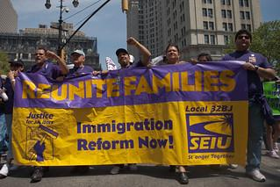
Immigration Trauma
Post-immigration Trauma
Pre-migration Trauma
Traumatic experiences faced in the home country.
Economic hardship,
Violence,
Prosecution,
Colonization Trauma
Natural Disasters
Challenges immigrants face after arriving in the new country.
Barriers ( Language, economics)
Discrimination
Culture Adjustments
Stressors contribute to ongoing trauma
Lasting impact of migration Trauma on:
Family Systems
Mental Health

Slide 9
Violence, Oppression, and Power Imbalance
Systemic Discrimination
Racism
Colorism
Classism
Gender Discrimination
Human rights violations

Slide 10
Inter-generational Trauma
Colonization Trauma is transmitted across generations
Trauma affects individuals who:
Suffered it directly
Witness it in their environment
Future generations
Its implication on mental health and wellbeing
Intergenerational Trauma affects mental health, cultural identity, and social cohesion.

Slide 11
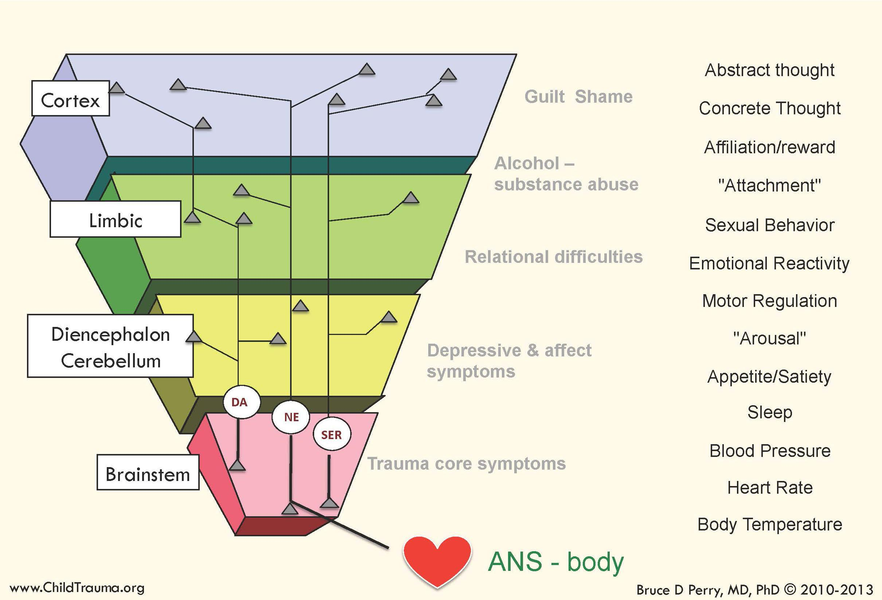
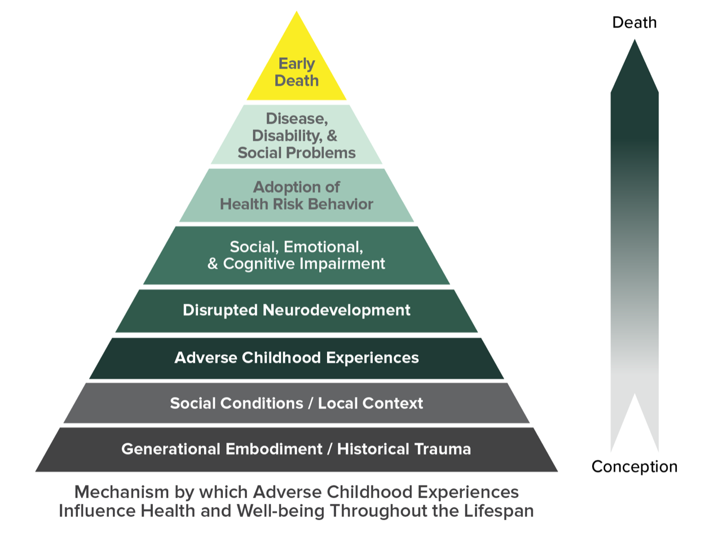
Inter-generational Trauma

Slide 12
Psychological effects of Colonization & immigration Trauma
Common Psychological effects of Colonization Trauma
Individuals & Communities
Attachment
Depression
Anxiety
PTSD
Substance Abuse
Adjustment Disorders ( immigration)
Family Systems issues ( immigration)

Slide 13
Immigration Trauma Manifestations
PTSD – Intrusive thoughts, flashbacks, nightmares, sleep problems.
Anxiety and depression – Stressors of immigration such as acculturation, adjustments, discrimination, separation of family and network of support.
Acculturative Stress – Alienation, adaptation problems, social isolation, loss of identity.
Grief – Homesickness, family members left behind,
Family Systems problems – Stress during separation and challenges during reunification & rebuilding relationships.

Slide 14
Healing and Resilience
Important to recognize and validate colonization trauma
Cultural Humility Training
Advocacy and social change
Trauma-informed education and care
Resilience and healing practices within the affected communities
Trauma-informed care – Empathy to foster a sense of safety, trust, non-judgment, and empowerment
Narrative Therapy – Explore and understand the story people have internalized and how this shape their identity.
Holistic Approaches –Recognize individual’s unique needs: Mindfulness, Art therapy, body-centered therapy, expressive therapy,

Slide 15
Decolonization Efforts
Recognizes Historical Trauma and systemic oppression experienced by marginalized communities. (Imposter syndrome( Pauline Clance & Suzanne Imes, 1978) leads to stress, anxiety, and low self-esteem, burnout)
Challenges Eurocentric frameworks ( White savior complex, paternalism)
Attempts to restore indigenous Knowledge and practices (Storytelling, spirituality, close connections, diverse ways of knowing)
Restore cultural practices and self-determination
Reclaim Cultural Identities
Education and Awareness
Attempt to challenge and dismantle the ongoing effects of colonization and colonial mentalities.(Superiority complex, Assimilation and culture erasure)

Slide 16
THE END

